Slide 1
X10 Programming Language
Bo Li
Xi’an Jiaotong University
Feb,2022

Slide 2
5 Modules
Module 1: X10 Overview
Module 2: X10 Base Language
Module 3: X10 Intra-Place Parallelism
Module 4: X10 Places and DistArrays
Module 5：Challenge and Programming Model

Slide 3
Module 1: X10 Overview
Notes:
3

Slide 4
Module Overview
Goals
Partitioned Global Address Space (PGAS) Programming Model
X10 Project Overview
X10DT (briefly)
Notes:
X10 can be complicated – you need to know Java, PGAS and some extra stuff!
X10DT will be “Visual Studio for X10”

Slide 5
Goals and Prerequisites
Provide rudimentary programming ability in X10
You won’t be an expert, but you won’t be baffled when presented with code
Describe X10 approaches for multilevel parallelism through code reuse
Notes:
rudimentary [,ru:di'mentəri] 报错
adj. 基本的；初步
baffled
基本翻译
v. 阻碍；使迷惑（baffle的过去式）
adj. 带有挡板的
网络释义
baffled:感到困惑 | 带有挡板的 | 古屋惊魂
百科
baffled
baffled:v. 阻碍(阻挡,挫折,因扰,反抗)a. 带障板的(阻挡的)例句与用法:1. The question baffled me completely and I could not... 详细 »
搜索 baffled

Slide 6
Prerequisites
Experience with parallel programming, either MPI or OpenMP.
Basic knowledge of Java (e.g., objects, messages, classes, inheritance).
Online tutorials are available at http://java.sun.com/docs/books/tutorial/
The “Getting Started” and “Learning the Java Language” tutorials are recommended.
Familiarity with basic linear algebra and matrix operations.

Slide 7
Scientific Simulation: The Third Pillar of Science
Traditional scientific and engineering paradigm:
Do theory or paper design.
Perform experiments or build system.
Limitations:
Too difficult -- build large wind tunnels.
Too expensive -- build a throw-away passenger jet.
Too slow -- wait for climate or galactic evolution.
Too dangerous -- weapons, drug design, climate experimentation.
Computational science paradigm:
Use high performance computer systems to simulate the phenomenon
Base on known physical laws and efficient numerical methods.

Slide 8
The quest for increasingly more powerful machines
Scientific simulation will continue to push on system requirements:
To increase the precision of the result
To get to an answer sooner (e.g., climate modeling, disaster modeling)
The U.S. will continue to acquire systems of increasing scale
For the above reasons
And to maintain competitiveness

Slide 9
https://www.top500.org/
China Extends Lead in Number of TOP500 Supercomputers, US Holds on to Performance Advantage
November 18, 2019
The 54th edition of the TOP500 saw China and the US maintaining their dominance of the list, albeit in different categories.
Meanwhile, the aggregate performance of the 500 systems, based on the High Performance Linpack (HPL) benchmark, continues to rise and now sits at 1.65 exaflops.
The entry level to the list has risen to 1.14 petaflops, up from 1.02 petaflops in the previous list in June 2019.
Notes:
中国扩大了TOP500超级计算机的数量，美国保持了性能优势第54届TOP500排名中，中国和美国保持了统治地位，尽管类别有所不同。 同时，基于高性能Linpack（HPL）基准的500个系统的总体性能不断提高，目前为1.65 exaflops。 该列表的入门级别已从2019年6月的上一个列表的1.02 petaflops增加到1.14 petaflops。

Slide 10
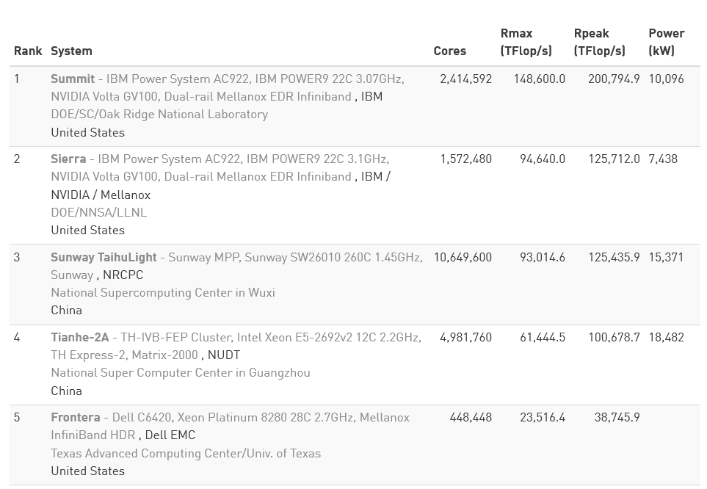
TOP 5 Sites for November 2019

Slide 11
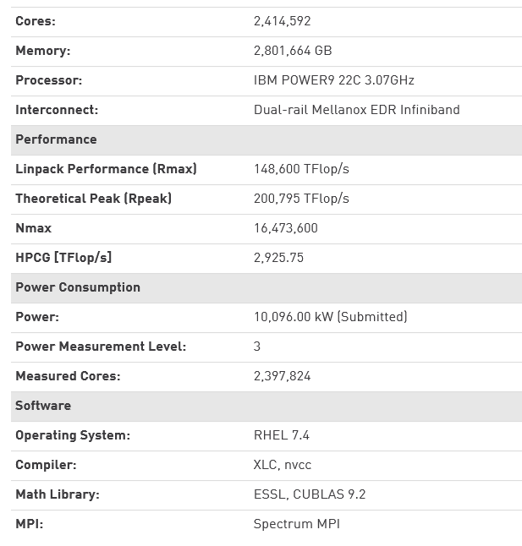
Summit - IBM Power System AC922, IBM POWER9 22C 3.07GHz, NVIDIA Volta GV100, Dual-rail Mellanox EDR Infiniband

Slide 12
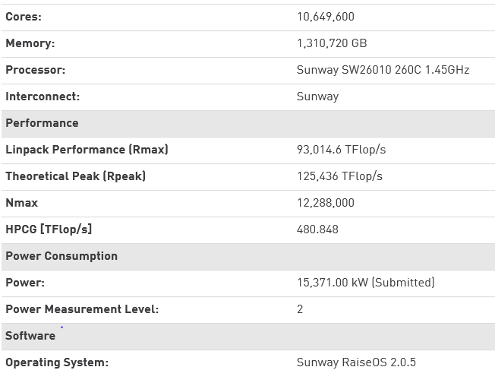
Sunway TaihuLight - Sunway MPP, Sunway SW26010 260C 1.45GHz, Sunway

Slide 13
TOP10 November 2012
Titan - Cray XK7 , Opteron 6274 16C 2.200GHz, Cray Gemini interconnect, NVIDIA K20x
Sequoia - BlueGene/Q, Power BQC 16C 1.60 GHz, Custom
K computer, SPARC64 VIIIfx 2.0GHz, Tofu interconnect
Mira - BlueGene/Q, Power BQC 16C 1.60GHz, Custom
JUQUEEN - BlueGene/Q, Power BQC 16C 1.600GHz, Custom Interconnect
SuperMUC - iDataPlex DX360M4, Xeon E5-2680 8C 2.70GHz, Infiniband FDR
Stampede - PowerEdge C8220, Xeon E5-2680 8C 2.700GHz, Infiniband FDR, Intel Xeon Phi
Tianhe-1A - NUDT YH MPP, Xeon X5670 6C 2.93 GHz, NVIDIA 2050
Fermi - BlueGene/Q, Power BQC 16C 1.60GHz, Custom
DARPA Trial Subset - Power 775, POWER7 8C 3.836GHz, Custom Interconnect

Slide 14
Titan - Cray XK7
Opteron 6274 16C 2.200GHz, Cray Gemini interconnect, NVIDIA K20x
Site: DOE/SC/Oak Ridge National Laboratory
System URL: http://www.olcf.ornl.gov/titan/
Manufacturer: Cray Inc.
Cores: 560640
Linpack Performance (Rmax) 17590.0 TFlop/s
Theoretical Peak (Rpeak) 27112.5 TFlop/s
Power: 8209.00 kW
Memory: 710144 GB
Interconnect: Cray Gemini interconnect
Operating System: Cray Linux Environment

Slide 15
Tianhe-1A - NUDT YH MPP
Xeon X5670 6C 2.93 GHz, NVIDIA 2050
Site: National Supercomputing Center in Tianjin
Manufacturer: NUDT
Cores: 186368
Linpack Performance (Rmax) 2566.0 TFlop/s
Theoretical Peak (Rpeak) 4701.0 TFlop/s
Power: 4040.00 kW
Memory: 229376 GB
Interconnect: Proprietary
Operating System: Linux
Compiler: icc
Math Library:
MPI: MPICH2 with a custom GLEX channel

Slide 16
Jaguar (Cray XT5)
Oak Ridge National
Laboratory
~37,000 processor chips
(224,162 cores)
AMD 6-core Opterons
1.759 Petaflop/second
One quadrillion operations/s
1 x 10¹⁶
What is its name?
Where is it located?
How many processors does it have?
What kind of processors?
How fast is it?
See http://www.top500.org

Slide 17
RoadRunner
Los Alamos National
Laboratory
~19,000 processor chips
(~129,600 “processors”)
AMD Opterons and
IBM Cell/BE (in Playstations)
1.105 Petaflop/second
One quadrilion operations/s
1 x 10¹⁶
What is its name?
Where is it located?
How many processors does it have?
What kind of processors?
How fast is it?
See http://www.top500.org

Slide 18
Parallel and Distributed Computing
Parallel computing (processing):
the use of two or more processors (computers), usually within a single system, working simultaneously to solve a single problem.
Distributed computing (processing):
any computing that involves multiple computers remote from each other that each have a role in a computation problem or information processing.
Parallel programming:
the human process of developing programs that express what computations should be executed in parallel.
The era of the mighty single-processor computer is over.
Now, when more computing power is needed.
All Computers are Parallel Computers.

Slide 19
Parallel Programming Complexity
An Analogy to Preparing Thanksgiving Dinner
Enough parallelism? (Amdahl’s Law)
Suppose you want to just serve turkey
Granularity
How frequently must each assistant report to the chef
After each stroke of a knife? Each step of a recipe? Each dish completed?
Locality
Grab the spices one at a time? Or collect ones that are needed prior to starting a dish?
Load balance
Each assistant gets a dish? Preparing stuffing vs. cooking green beans?
Coordination and Synchronization
Person chopping onions for stuffing can also supply green beans
Start pie after turkey is out of the oven
All of these things makes parallel programming even harder than sequential programming.
Notes:
recipe [['resɪpɪ]]
基本翻译
n. 食谱；[临床] 处方；秘诀
网络释义
recipe:食谱 | 处方 | 烹饪法
one at a time
基本翻译
adv. 一次一个人
网络释义
one at a time:每次一个 | 一次一个人 | 一次性
start a dish
开始一盘
stuffing [['stʌfɪŋ]]
基本翻译
n. 填料，填塞物
网络释义
STUFFING:填充物 | 填料 | 填充料
get a dish
得到一个菜

Slide 20
Background
The problem, then, is how to use those computer cycles effectively.
divide up the available work into chunks
executed simultaneously
without introducing undesirable indeterminacy,
without cycles of “deadly embrace”
move to a fragmented memory model.
Multiple processors are programmed largely as if they were uniprocessors, but are made to interact via a relatively language-neutral message-passing format such as MPI
Deadly embrace: jam up processors or causing processors to spin uselessly waiting for conditions that may never materialize.
Notes:
The era of the mighty single-processor computer is over. Now, when more computing power is needed, one does not buy a faster uniprocessor—one buys another processor just like those one already has, or another hundred, or another million, and connects them with a high-speed communication network. Or, perhaps, one rents them instead, with a cloud computer. This gives one whatever number of computer cycles that one can desire and afford.
强大的单处理器计算机时代已经结束。现在，当需要更多的计算能力时，人们不必购买速度更快的单处理器，而是购买另一处理器，就像已经拥有的处理器，另一百或另一百万的处理器一样，然后将它们与高速通信网络连接。或者，也许有人改为用云计算机租用它们。这给出了一个人们可以期望和负担的任意数量的计算机周期。
The problem, then, is how to use those computer cycles effectively. One must understand how to divide up the available work into chunks that can be executed simultaneously without introducing undesirable indeterminacy, cycles of “deadly embrace” which jam up processors or causing processors to spin uselessly waiting for conditions that may never materialize.
One response to this problem has been to move to a fragmented memory model. Multiple processors are programmed largely as if they were uniprocessors, but are made to interact via a relatively language-neutral message-passing format such as MPI .
那么，问题是如何有效地利用那些计算机周期。必须了解如何将可用工作划分为多个块，这些块可以同时执行而不会引起不希望的不确定性，“致命拥抱”周期会阻塞处理器或导致处理器无用地等待可能永远不会实现的条件。解决此问题的一种方法是迁移到碎片化的内存模型。多个处理器的编程就好像它们是单处理器一样，但是通过相对语言中立的消息传递格式（例如MPI）进行交互。

Slide 21
MPI
This model has enjoyed some success:
several high-performance applications have been written in this style.
Unfortunately, this model leads to a loss of programmer productivity:
the message-passing format is integrated into the host language by means of an application-programming interface (API), the programmer must explicitly represent and manage the interaction between multiple processes and choreograph their data exchange;
large data-structures (such as distributed arrays, graphs, hash-tables) that are conceptually unitary must be thought of as fragmented across different nodes;
all processors must generally execute the same code in an Single Program Multiple Data (SPMD) fashion etc.
Notes:
This model has enjoyed some success: several high-performance applications have been written in this style. Unfortunately, this model leads to a loss of programmer productivity: the message-passing format is integrated into the host language by means of an application-programming interface (API), the programmer must explicitly represent and manage the interaction between multiple processes and choreograph their data exchange; large data-structures (such as distributed arrays, graphs, hash-tables) that are conceptually unitary must be thought of as fragmented across different nodes; all processors must generally execute the same code in an Single Program Multiple Data (SPMD) fashion etc.
此模型取得了一定的成功：已经用这种样式编写了一些高性能应用程序。不幸的是，这种模型导致程序员工作效率的下降：消息传递格式通过应用程序编程接口（API）集成到宿主语言中，程序员必须显式表示和管理多个流程之间的交互，并编排其内容。数据交换;必须将概念上单一的大型数据结构（例如分布式数组，图形，哈希表）视为跨不同节点的碎片；通常，所有处理器必须以单程序多数据（SPMD）方式等执行相同的代码。

Slide 22
PGAS Background
The partitioned global address space (PGAS) model underlying languages such as UPC, Titanium and Co-Array Fortran.
These languages permit the programmer to think of a single computation running across multiple processors, sharing a common address space.
All data resides at some processor, which is said to have affinity to the data.
Each processor may operate directly on the data it contains but must use some indirect mechanism to access or update data at other processors.
Some kind of global barriers are used to ensure that processors remain roughly synchronized.
Notes:
One response to this problem has been the advent of the partitioned global address space (PGAS) model underlying languages such as UPC, Titanium and Co-Array Fortran]. These languages permit the programmer to think of a single computation running across multiple processors, sharing a common address space. All data resides at some processor, which is said to have affinity to the data. Each processor may operate directly on the data it contains but must use some indirect mechanism to access or update data at other processors. Some kind of global barriers are used to ensure that processors remain roughly synchronized.
对这一问题的一种应对方法是诸如UPC，Titanium和Co-Array Fortran等基础语言的分区全局地址空间（PGAS）模型的问世。这些语言允许程序员考虑跨多个处理器运行的单个计算，共享一个公共地址空间。所有数据都驻留在某个处理器上，据称该处理器与数据具有亲和力。每个处理器可以直接对它包含的数据进行操作，但是必须使用某种间接机制来访问或更新其他处理器上的数据。使用某种全局性障碍来确保处理器保持大致同步。

Slide 23
Global Views
A parallel program consists of a set of threads and at least one address space
A program is said to have a global view if all threads share a single address space (e.g., OpenMP)
Tough to see when threads share same data
Bad data sharing causes race conditions (incorrect answers) and communication overhead (poor performance)
Notes:
Popular parallel programming models that lead to PGAS
I’ll ignore the process/thread distinction for now and use a thread to mean “a program counter” or “an activity in the program”
OpenMP is good because it’s easy – matches memory model of sequential programming
MPI is good because it’s fast – the programmer is forced to manage data across the address spaces

Slide 24
Local Views
A program is said to have a local view
if the threads have distinct address spaces and pass messages to communicate (e.g., MPI)
Message passing code introduces a lot of bookkeeping to applications
Threads need individual copies of all data required to do their computations (which can lead to replicated data)
Notes:
bookkeeping [['bʊkkiːpɪŋ]]
基本翻译
n. 记帐，簿记
网络释义
bookkeeping:簿记 | 记账 | 记帐

Slide 25
PGAS Overview
“Partitioned Global View” (or PGAS)
Global Address Space: Every thread sees entire data set, so no need for replicated data
Partitioned: Divide global address space so programmer is aware of data sharing among threads
Implementations
GA Library from PNNL
Unified Parallel C (UPC), FORTRAN 2009
X10, Chapel
Notes:
Like other software features, you can implement PGAS in a library or build it into a language
Co-Array FORTRAN was the PGAS variant of FORTRAN. Now, PGAS in FORTRAN standard as of 2009
PNNL
网络释义
PNNL:西北太平洋国家实验室(Pacific Northwest National Laboratory)

Slide 26
Concepts
Memories and structures
Partition and mapping
Threads and affinity
Local and non-local accesses
Collective operations and “Owner computes”

Slide 27
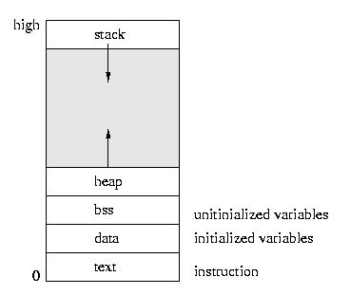
Software Memory Examples
Executable Image at right
“Program linked, loaded and ready to run”
Memories
Static memory
data segment
Heap memory
Holds allocated structures
Explicitly managed by programmer (malloc, free)
Stack memory
Holds function call records
Implicitly managed by runtime during execution
Notes:
When someone says “memory”, I normally think about hardware memory.
But, we have had distinct software memories in computer science for some time. Here is an example from traditional computer science.
Figure courtesy http://www.andrew.cmu.edu/course/15-440-sp09/applications/ln/lecture2.html

Slide 28
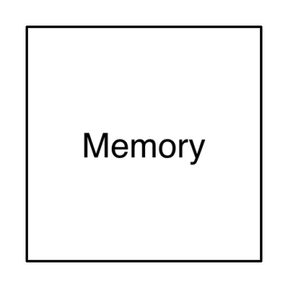
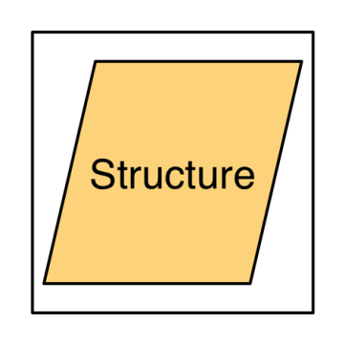
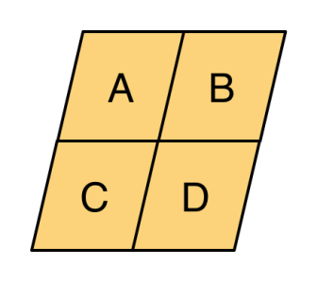
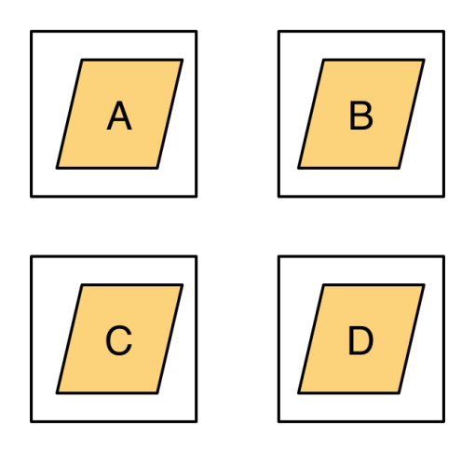
Memories and Distributions
Software Memory
Distinct logical storage area in a computer program (e.g., heap or stack)
For parallel software, we use multiple memories
In X10, a memory is called a place
Structure
Collection of data created by program execution (arrays, trees, graphs, etc.)
Partition
Division of structure into parts
Mapping
Assignment of structure parts to memories
In X10, partitioning and mapping information for an array are stored in a distribution
Notes:
These are common elements that are all represented in GA library, UPC, FORTRAN 2009 and X10.

Slide 29
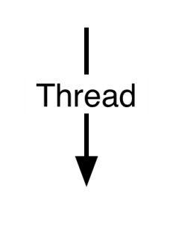
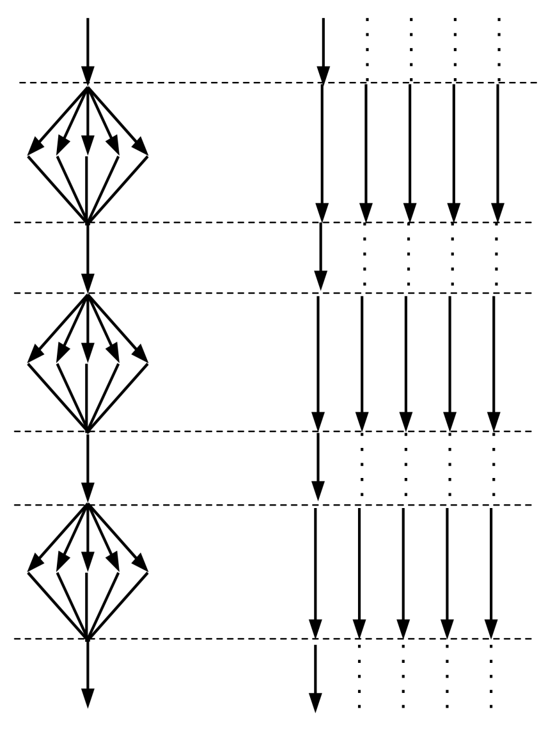
Threads
Units of execution
Structured threading
Dynamic threads: program creates threads during execution (e.g., OpenMP parallel loop)
Static threads: same number of threads running for duration of program
Single program, multiple data (SPMD)
Threads in X10 (activities) are created with async and at
Notes:
SPMD execution is common to UPC and FORTRAN
POSIX threading provides support for unstructured threads

Slide 30
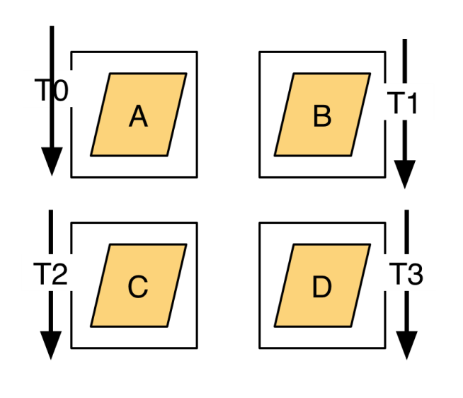
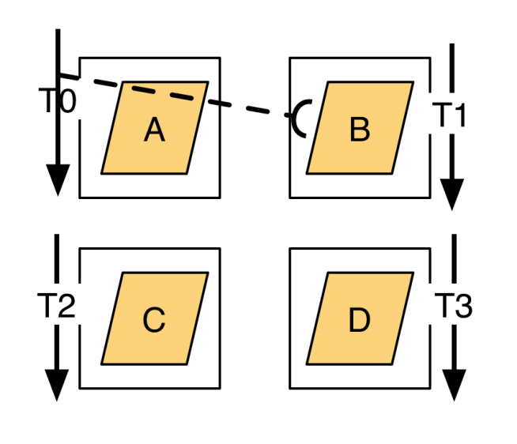
Affinity and Nonlocal Access
Affinity is the association of a thread to a memory
If a thread has affinity with a memory, it can access its structures
Such a memory is called a local memory
Nonlocal access
Thread 0 wants part B
Part B in Memory 1
Thread 0 does not have affinity to memory 1
Nonlocal accesses often implemented via interprocess communication – which is expensive!
Notes:
Programmer is aware of this nonlocal access!
affinity [[ə'fɪnɪtɪ]]
基本翻译
n. 密切关系；吸引力；姻亲关系；类同
网络释义
affinity:亲和力 | 姻亲关系 | 亲合力

Slide 31
Collective operations and “Owner computes”
Collective operations are performed by a set of threads to accomplish a single global activity
For example, allocation of a distributed array across multiple places
“Owner computes” rule
Distributions map data to (or across) memories
Affinity binds each thread to a memory
Assign computations to threads with “owner computes” rule
Data must be updated (written) by a thread with affinity to the memory holding that data

Slide 32
Threads and Memories for Different Programming Methods
 | Thread Count | Memory Count | Nonlocal Access
Sequential | 1 | 1 | N/A
OpenMP | Either 1 or p | 1 | N/A
MPI | p | p | No. Message required.
CUDA | 1 (host) + p (device) | 2 (Host + device) | No. DMA required.
UPC, FORTRAN | p | p | Supported.
X10 | n | p | Supported.

Slide 33
What is X10?
The fundamental goal of X10 is to enable scalable, high performance, high-productivity transformational programming for high-end computers—for traditional numerical computation workloads (such as weather simulation, molecular dynamics, particle transport problems etc) as well as commercial server workloads, such as big data analytics.
high-performance, high productivity computing on high-end computers supporting 10⁵ hardware threads and 10¹⁵ operations per second.
X10 is a statically typed object-oriented language, extending a sequential core language with places, activities, clocks, (distributed, multi-dimensional) arrays and struct types.
Notes:
The fundamental goal of X10 is to enable scalable, high performance, high-productivity transformational programming for high-end computers—for traditional numerical computation workloads (such as weather simulation, molecular dynamics, particle transport problems etc) as well as commercial server workloads, such as big data analytics.

Slide 34
Based on state-of-the-art object-oriented programming
ideas primarily to take advantage of their proven flexibility and ease-of-use for a wide spectrum of programming problems.
introduces new constructs that significantly simplify scale out programming.
intended to have a simple and clear semantics and be readily accessible to mainstream OO programmers.
intended to support a wide variety of concurrent programming idioms
Notes:
X10 is the first of the second generation of PGAS languages. It is a modern objectoriented programming language that introduces new constructs that significantly simplify scale out programming. The fundamental goal of X10 is to enable scalable, highperformance, high-productivity transformational programming for high-end computers—for traditional numerical computation workloads (such as weather simulation, molecular dynamics, particle transport problems etc) as well as commercial server workloads, such as big data analytics.
X10是第二代PGAS语言的第一代。它是一种现代的面向对象的编程语言，它引入了可显着简化横向扩展编程的新结构。 X10的基本目标是为高端计算机实现可扩展的，高性能，高生产率的转换编程-适用于传统的数值计算工作负载（例如天气模拟，分子动力学，粒子传输问题等）以及商业服务器工作负载，例如作为大数据分析。
X10 is based on state-of-the-art object-oriented programming ideas primarily to take advantage of their proven flexibility and ease-of-use for a wide spectrum of programming problems.

Slide 35
Numerical computing
How to adapt such languages to the context of high-performance numerical computing.
user-defined struct types (such as Int, Float, Complex etc) and function literals,
a very flexible form of multi-dimensional arrays (based on ideas in ZPL)
IEEE-standard floating point arithmetic.
Some capabilities for overloading operator.
Notes:
X10 takes advantage of several years of research (e.g., in the context of the Java Grande forum, ) on how to adapt such languages to the context of high-performance numerical computing. Thus X10 provides support for user-defined struct types (such as Int, Float, Complex etc) and function literals, supports a very flexible form of multi-dimensional arrays (based on ideas in ZPL) and supports IEEE-standard floating point arithmetic. Some capabilities for overloading operator are also provided.
X10基于最新的面向对象编程思想，主要是利用其经过验证的灵活性和易用性来解决各种编程问题。 X10利用了数年的研究优势（例如，在Java Grande论坛中），研究如何使此类语言适应高性能数值计算的环境。因此，X10支持用户定义的结构类型（例如Int，Float，Complex等）和函数文字，并支持非常灵活的多维数组形式（基于ZPL中的思想），并支持IEEE标准浮点算法。还提供了一些用于重载运算符的功能。

Slide 36
The first of the second generation of PGAS languages.
X10 introduces a flexible treatment of concurrency, distribution and locality, within an integrated type system.
X10 extends the PGAS model with asynchrony (yielding the APGAS programming model).
X10 introduces places as an abstraction for a computational context with a locally synchronous view of shared memory.
An X10 computation runs over a large collection of places.
Each place hosts some data and runs one or more activities.
Activities are lightweight threads of execution.
Activities can be dynamically created.
An activity may synchronously (and atomically) use one or more memory locations in the place in which it resides, leveraging current symmetric multiprocessor (SMP) technology.
Notes:
X10 introduces a flexible treatment of concurrency, distribution and locality, within an integrated type system. X10 extends the PGAS model with asynchrony (yielding the APGAS programming model). X10 introduces places as an abstraction for a computational context with a locally synchronous view of shared memory. An X10 computation runs over a large collection of places. Each place hosts some data and runs one or more activities. Activities can be dynamically created. Activities are lightweight threads of execution. An activity may synchronously (and atomically) use one or more memory locations in the place in which it resides, leveraging current symmetric multiprocessor (SMP) technology.
X10在集成类型系统中引入了对并发，分布和位置的灵活处理。 X10通过异步扩展了PGAS模型（产生了APGAS编程模型）。 X10通过共享内存的本地同步视图将场所作为计算上下文的抽象引入。 X10计算运行在大量地点上。每个地方都承载一些数据并运行一个或多个活动。活动可以动态创建。活动是执行的轻量级线程。活动可以利用当前对称多处理器（SMP）技术同步（原子地）使用其驻留的位置中的一个或多个内存位置。

Slide 37
Execution control
A distributed termination construct finish enables code to execute after all activities in the given statement have terminated, thus ensuring that all their side-effects have already taken place.
An activity may shift to another place to execute a statement block.
X10 provides weaker ordering guarantees for inter-place data access, enabling applications to scale.
Multiple memory locations in multiple places cannot be accessed atomically.
Immutable data needs no consistency management and may be freely copied by the implementation between places.
One or more clocks may be used to order activities running in multiple places.
DistArrays, distributed arrays, may be distributed across multiple places and support parallel collective operations.
A novel exception flow model ensures that exceptions thrown by asynchronous activities can be caught at a suitable parent activity.
Asynchronous initialization of variables is supported.
Linking with native code is supported.
Notes:
A distributed termination construct finish enables code to execute after all activities in the given statement have terminated, thus ensuring that all their side-effects have already taken place. An activity may shift to another place to execute a statement block. X10 provides weaker ordering guarantees for inter-place data access, enabling applications to scale. Multiple memory locations in multiple places cannot be accessed atomically. Immutable data needs no consistency management and may be freely copied by the implementation between places. One or more clocks may be used to order activities running in multiple places. DistArrays, distributed arrays, may be distributed across multiple places and support parallel collective operations. A novel exception flow model ensures that exceptions thrown by asynchronous activities can be caught at a suitable parent activity. Asynchronous initialization of variables is supported. Linking with native code is supported.
分布式终止构造完成使代码能够在给定语句中的所有活动终止之后执行，从而确保所有副作用已经发生。活动可能会转移到另一个地方来执行语句块。 X10为场所间数据访问提供了较弱的订购保证，从而使应用程序可以扩展。无法自动访问多个位置的多个内存位置。不变的数据不需要一致性管理，并且可以通过实现在场所之间自由复制。一个或多个时钟可用于订购在多个地方运行的活动。 DistArrays是分布式数组，可以分布在多个地方并支持并行的集合操作。新颖的异常流模型可确保异步活动引发的异常可以在适当的父活动中捕获。支持变量的异步初始化。支持与本机代码的链接。

Slide 38
X10 new concepts
X10 is an instance of the Asynchronous PGAS model in the Java family
Threads can be dynamically created under programmer control (as opposed to SPMD execution of MPI, UPC, FORTRAN)
n distinct threads, p distinct memories
n <> p
PGAS memories are called places in X10
PGAS threads are called activities in X10
Asynchronous extensions for other PGAS languages (UPC, FORTRAN 2009) entirely possible…
Notes:
opposed to
基本翻译
反对；反对…的
网络释义
opposed to:反对
entirely [[ɪn'taɪəlɪ; en-]]
基本翻译
adv. 完全地，彻底地
网络释义
entirely:完全地 | 全然地 | 全部

Slide 39
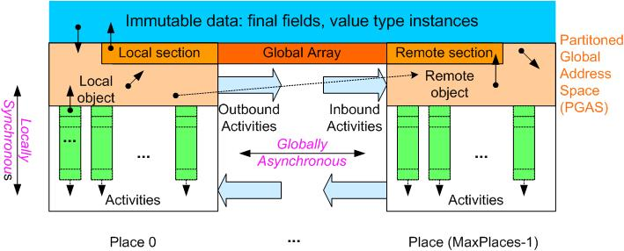
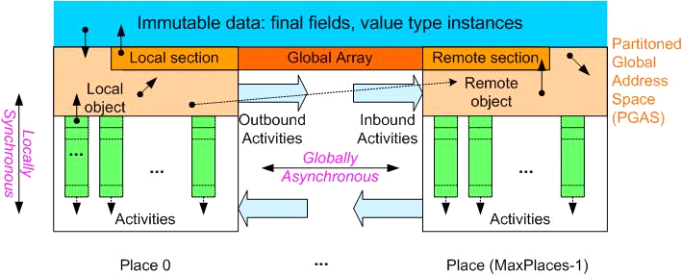
X10 Concepts
PGAS:
Replicated Data
Local Heap
Remote Heap
Locality Rule: Any access to a mutable datum must be performed by a local activity
➔ remote data accesses can be performed by creating remote activities
Place = collection of resident activities and objects
Activity = sequential computation that runs at a place
Locally Synchronous: Guaranteed coherence for local heap ➔ sequential consistency
Globally Asynchronous: No ordering of inter-place activities ➔ use explicit synchronization for coherence
Storage classes:
Activity-local
Place-local
Partitioned global
Immutable
Ordering Constraints (Memory Model)

Slide 40
X10 Constructs
Fine grained concurrency
async S
Atomicity
atomic S
when (c) S
Global data-structures
points, regions, distributions, arrays
Place-shifting operations
at (P) S
Ordering
finish S
clock
Two basic ideas: Places and Asynchrony

Slide 41
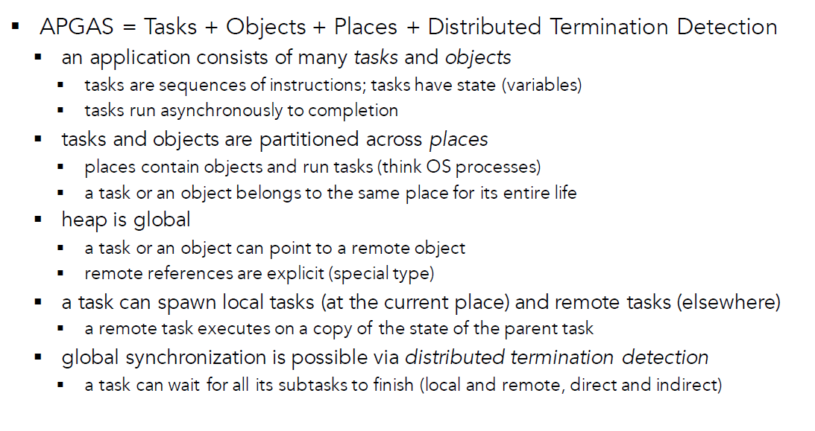
APGAS

Slide 42
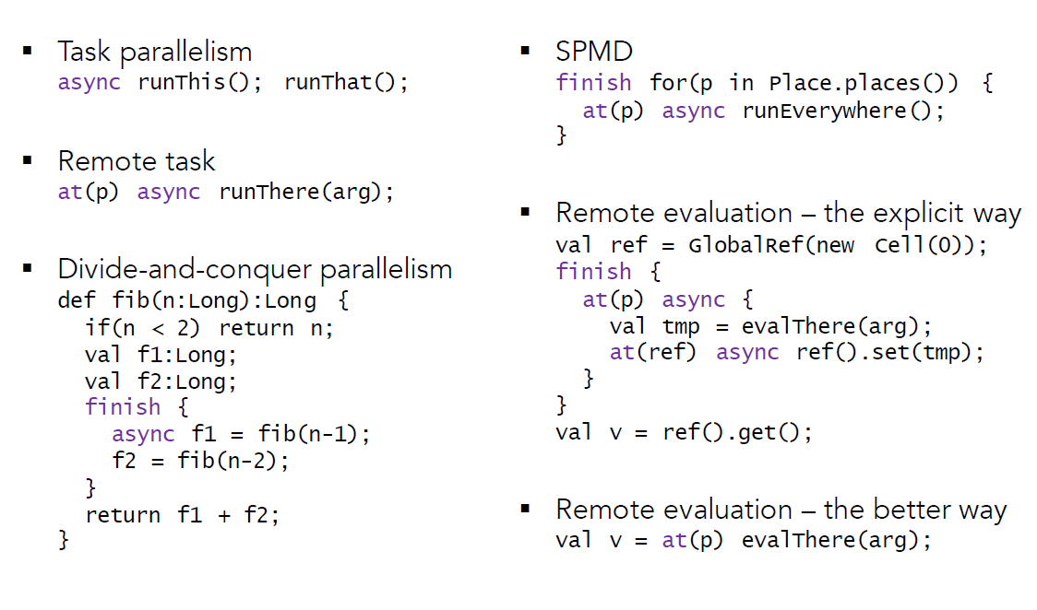
APGAS constructs

Slide 43
Conclusion
X10 is considerably higher-level than thread-based languages and Yet it is much more concrete than languages like HPF
Features of thread-based languages
supports dynamically spawning lightweight activities
atomic operations for mutual exclusion
clocks for repeated quiescence detection.
HPF
forces the programmer to explicitly deal with distribution of data objects.
The X10 designers’ belief
locality and distribution cannot be hidden from the programmer of high-performance code in high-end computing.
A performance model that distinguishes between computation and communication must be made explicit and transparent.
the place-based type system and support for generic programming will allow the X10 programmer to be highly productive
many of the tedious details of distribution-specific code can be handled in a generic fashion.

Slide 44
X10 Project Status
X10 is developed by the IBM PERCS project as part of the DARPA program on High Productivity Computing Systems (HPCS)
Target markets: Scientific computing, business analytics
X10 is an open source project (Eclipse Public License)
Documentation, releases, mailing lists, code, etc. all publicly available via http://x10-lang.org
X10 Release 2.6.2-January 4, 2019
X10 2.6.2 contains updates for new versions of Java and MacOS
- Managed X10 support for Java SE 11
- Native X10 support for current MacOS versions
Notes:
X10 2.6.2 contains updates for new versions of Java and MacOS
- Managed X10 support for Java SE 11
- Native X10 support for current MacOS versions
LIMITATIONS OF THIS RELEASE
The size and index of arrays must be less than 2^31 with Managed X10.
An attempt to allocate a longer array causes IllegalArgumentException.
The following features described in the 2.6 language manual do not
currently work and may be fixed in the subsequent releases:
- Non-static type definitions as class or interface members
(static type defs do work)
The constraint solver used by X10 typechecker is known to be incomplete
for situations in which a constraint implies an infinite number of
distinct constraints.
Additionally, the following features described in the language
manual do not currently work with Native X10.
- Non-final generic instance methods
- Exception stack traces on Cygwin
The generated C++ code requires g++ 4.2 or better to be compiled;
we do almost all of our testing against g++ 4.4.
+ On Power/Linux you may either use g++ 4.2 or better
or xlC 11.1 or better.
SUMMARY OF ISSUES RESOLVED IN THIS RELEASE
Below is a summary of JIRA issues addressed for the X10 2.6.1
* [XTENLANG-3543] - x10c needs to work with JDK9
* [XTENLANG-3559] - Fix Illegal Access Warnings from Java 9+
* [XTENLANG-3561] - Fixes for NativeX10 on MacOS 10.12 and 10.13
* [XTENLANG-3562] - Upgrade to BDWGC 8.0.2
For the details of JIRA issues fixed in this release, see
https://xtenlang.atlassian.net/secure/ReleaseNote.jspa?version=10700&projectId=10005
Please use the X10 JIRA to report bugs, after ensuring the problem is
not already reported:
https://xtenlang.atlassian.net/projects/XTENLANG/issues

Slide 45
Release 2.3.1 -March 2013
2.3 introduces significant improvements in X10/Java interoperability. A few backwards compatible language enhancements and some non backwards-compatible class library changes were made to improve the quality of Java interoperability.
Java types may now be imported/used in X10 programs just as-if they were X10 types.
An isref predicate (similar to iszero) has been added to X10's constraint language to enable identification of types that are constrained to be representable as a pointer.
X10 classes are no longer required to inherit from a single root class (x10.lang.Object).
x10.lang.Object has been removed from the standard library.
The exception hierarchy has been changed and checked exceptions and a throws clauses were reintroduced. The exception hierarchy now aligns neatly with Java's, although X10 prefers using unchecked exceptions as much as possible.

Slide 46
X10 2.1.0 released October 19, 2010
Java back end: Single process (all places in 1 JVM)
any platform with Java 5
C++ back end: Multi-process (1 place per SMP node)
aix, linux, cygwin, MacOS X
x86, x86_64, PowerPC, Sparc

Slide 47
X10 Goals
From “An Overview of X10 2.0”, SC09 Tutorial
Simple
Start with a well-accepted programming model, build on strong technical foundations, add few core constructs
Safe
Eliminate possibility of errors by design, and through static checking
Powerful
Permit easy expression of high-level idioms
Permit expression of high-performance programs
Scalable
Support high-end computing with millions of concurrent tasks
Universal
Present one core programming model to abstract from the current plethora of architectures.
Notes:
eliminate [[ɪ'lɪmɪneɪt]]
基本翻译
vt. 消除；排除
网络释义
eliminate:消除 | 淘汰 | 排除
idioms
基本翻译
n. 成语；惯用语；方言；风格（idiom的复数）
网络释义
Idioms:习语 | 成语 | 惯用语
plethora ['pleθərə]
基本翻译
n. 过多；过剩；[医] 多血症
网络释义
plethora:多余 | 多血症 | 过剩
From SC09 X10 tutorial. David Grove, et. al.
Want to emphasize universal – ties into my motivation

Slide 48
X10 Motivation
Modern HPC architectures combine products
From desktop/enterprise market: processors, motherboards
HPC market: interconnects (IB, Myrinet), storage, packaging, cooling
Computing dominated by power consumption
In desktop/enterprise market emergence of multicore
HPC will retain common processor architecture with enterprise
In HPC, we seek even higher flops/watt. Manycore is leading candidate
nVidia Fermi: 512 CUDA cores
Intel Knights Corner: >50 Cores, Many Integrated Core( MIC ) Architecture (pronounced “Mike”)
Notes:
dominate by
基本翻译
通过…控制，为…所左右：；被俯视：

Slide 49
X10 Motivation
HPC node architectures will be increasingly
Complicated (e.g., multicore, multilevel caches, RAM and I/O contention, communication offload)
Heterogenous (e.g, parallelism across nodes, between motherboard and devices (GPUs, IB cards), among CPU cores)
Programming Challenges
exhibit multiple levels of parallelism
synchronize data motion across multiple memories
regularly overlap computation with communication
Notes:
contention [[kən'tenʃ(ə)n]]
基本翻译
n. 争论，争辩；争夺；论点
网络释义
contention:争夺 | 争用 | 竞争
exhibit [[ɪg'zɪbɪt; eg-]]
基本翻译
vt. 展览；显示；提出（证据等）
n. 展览品；证据；展示会
vi. 展出；开展览会
网络释义
exhibit:展览 | 显示 | 展示

Slide 50
Every parallel architecture has a dominant programming model
Software Options
Pick existing model (MPI, OpenMP)
Kathy Yelick has interesting summary of challenges here
Hybrid software
MPI at node level
OpenMP at core level
CUDA at accelerator
Find a higher-level abstraction, map it to hardware
Parallel Architecture | Programming Model
Vector Machine (Cray 1) | Loop vectorization (IVDEP)
SIMD Machine (CM-2) | Data parallel (C*)
SMP Machine (SGI Origin) | Threads (OpenMP)
Clusters (IBM 1350) | Message Passing (MPI)
GPGPU (nVidia Fermi) | Data parallel (CUDA)
Accelerated Clusters | Asynchronous PGAS?
Notes:
Based on table from Dave Patterson and the Berkeley ParLab.
Higher-level abstraction gets back to X10 goal of a universal programming model

Slide 51
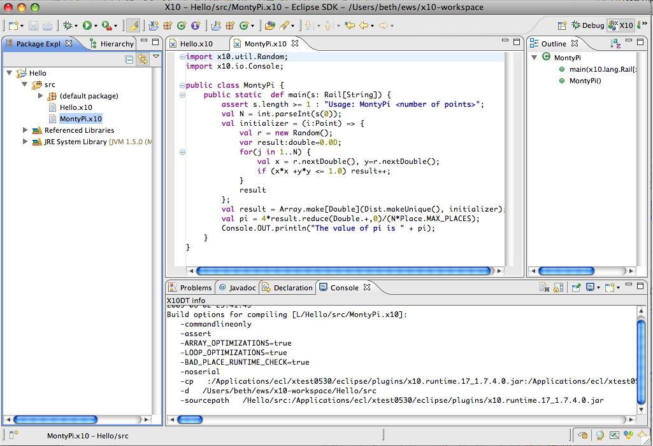
X10DT Overview
More information at http://x10-lang.org
Notes:
Point out source editor (syntax highlighting, content assist, hover), outline view, incremental builder, launch config, refactoring, debugging

Slide 52
Conclusions
PGAS fundamental concepts:
Data: Memory, partitioning and mapping
Threads: Static/Dynamic, affinity, nonlocal access
PGAS models expose remote accesses to the programmer
X10 is a general-purpose language providing asynchronous PGAS
Asynchronous PGAS may be a unified model to address the upcoming changes in petascale and exascale architectures
Notes:
affinity [[ə'fɪnɪtɪ]]
基本翻译
n. 密切关系；吸引力；姻亲关系；类同
网络释义
affinity:亲和力 | 姻亲关系 | 亲合力

Slide 53
Module 2: X10 Base Language
Notes:
53

Slide 54
Module Overview
How this tutorial is different
X10 Basics, Hello World, mathematical functions
Classes and objects
Functions and closures
Arrays
Putting it all together: Prefix Sum example

Slide 55
How this tutorial is different
Lots of other X10 materials online
Mostly language overviews and project summaries
Best way to learn a language is to use it
Focus on working code examples and introduce language topics and constructs as they arise
Focus on HPC-style numeric computing
Won’t exhaustively cover features of the language
Interfaces, exceptions, inheritance, type constraints, …
Won’t exhaustively cover implementations
Java back end, CUDA interface, BlueGene support, …

Slide 56
X10 Basics
X10 is an object-oriented language based on Java
Base data types
Non-numeric: Boolean, Byte, Char and String
Fixed point: Short, Int and Long
Floating point: Float, Double and Complex
Top level containers: classes and interfaces, grouped into packages
Objects are instantiated from classes

Slide 57
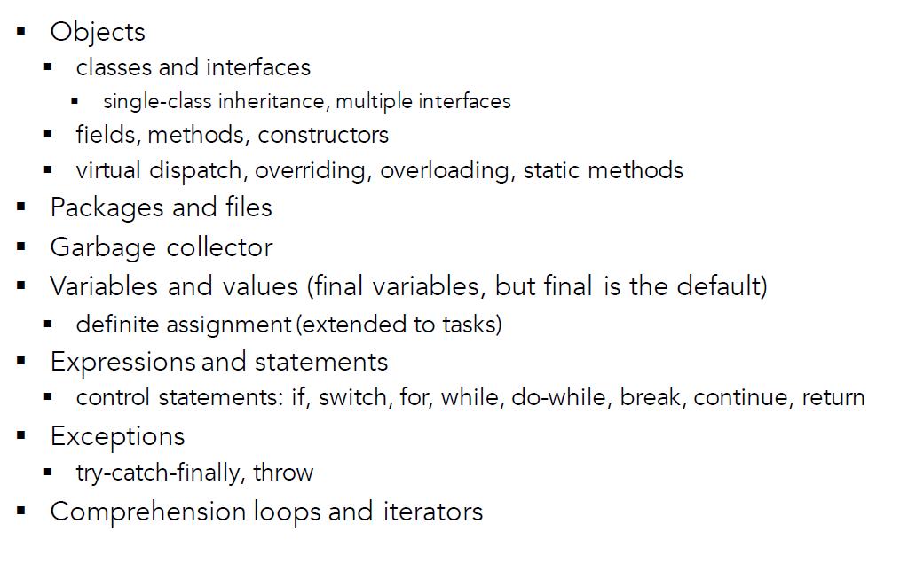
X10 likes Java

Slide 58
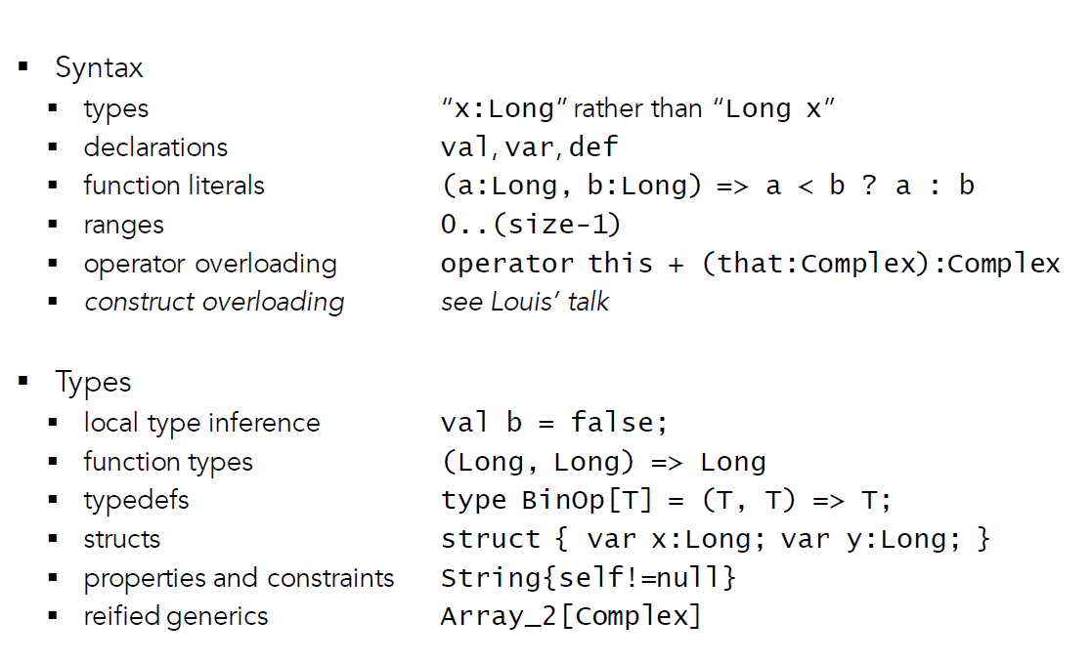
X10:Beyond Java

Slide 59
Hello World
public class Hello {
public static def main(var args: Array[String](1)):Void {
Console.OUT.println("Hello X10 world");
}
}
Program execution starts with main() method
Only one class can have a main method
Method declaration
Methods declared with def
Objects fields either methods (function) or members (data):
Access modifiers: public, private (like Java)
static declaration: field is contained in class and is immutable
Function return type here is Void
I/O provided by library x10.io.Console
Notes:
immutable [i'mju:təbl]
基本翻译
adj. 不变的；不可变的；不能变的
网络释义
immutable:不可变的 | 不变模式 | 不变

Slide 60
Hello World
public class Hello {
public static def main(var args: Array[String](1)):Void {
Console.OUT.println("Hello X10 world");
}
}
Variable Declarations: var <name> : <type>, like var x:Int
Example of generic types (similar to templates)
Array (and other data structures) take a base type parameter
For example
Array[String], Array[Int], Array[Double], …
Also, we provide dimension of Array, so Array[String](1) is a single-dimensional array of strings

Slide 61
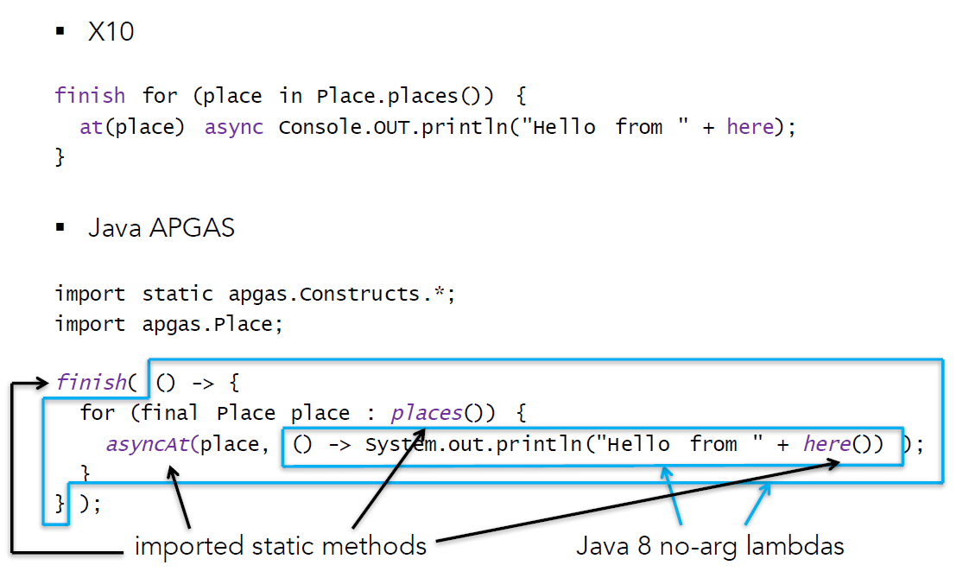
Helloworld in X10 and Java APGAS

Slide 62
Types in X10
public class MathTest {
public static def main(args: Array[String](1)):Void {
val w = 5;
val x = w as Double;
val y = 3.0;
val z = y as Int;
Console.OUT.println("w = " +w+ ", x = " +x+ ", y = " +y+ ", z = " +z);
val d1 = (Math.log(8.0)/Math.log(2.0)) as Int;
val d2 = Math.pow(2, d1) as Int;
Console.OUT.println("d1 = " + d1 + ", d2 = " + d2);
}
}
X10 type casting (coercion) using as
Calculate log₂ of a number using log₁₀
X10 math functions provided by Math library
val – declares a value (immutable)
Type inference used to deduce type, no declaration needed
X10 community says var/val = Java’s non‐final/final
Declare everything val unless you explicitly need var
Let the type system infer types whenever possible
Notes:
coercion [kəu'ə:ʃən]
基本翻译
n. 强制；强迫；高压政治；威压
网络释义
coercion:强制转换 | 强迫 | 强制型转

Slide 63
Classes
public class Counter {
var counterValue:Int;
public def this() {
counterValue = 0;
}
public def this(initValue:Int) {
counterValue = initValue;
}
public def count() {
counterValue++;
}
public def getCount():Int {
return counterValue;
}
}
Instance declarations allocated with each object (e.g., counterValue)
Class declarations allocated once per class
static
this
val containing reference to lexically enclosing class
Here, it is Counter
Constructors automatically called on object instantiation
In Java, use Counter(), in X10, use this()
Notes:
Provided examples of the 3 basic kinds of methods: constructors, setters and getters
Constructors initialize objects upon instantiation.
Setters change internal object state.
Getters return internal object state.

Slide 64
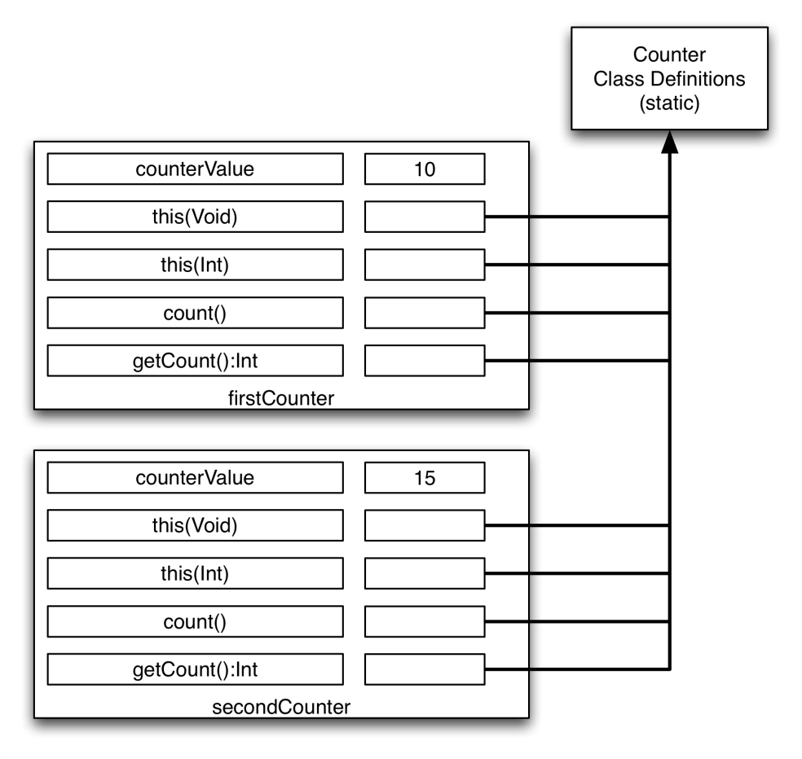
Objects
class Driver {
public static def main(args:Array[String](1)):Void {
val firstCounter = new Counter();
val secondCounter = new Counter(5);
for (var i:Int=0; i<10; i++) {
firstCounter.count();
secondCounter.count();
}
val firstValue = firstCounter.getCount();
val secondValue = secondCounter.getCount();
Console.OUT.println("First value = "+firstValue);
Console.OUT.println("Second value = "+secondValue);
}
}
How about the relationship between objects and their methods?
Object instantiation with new
firstCounter uses default constructor, secondCounter uses initialization constructor
X10 has garbage collection, so no malloc/free. Object GC’ed when it leaves scope
Example of C-style for loop
Modifying i, so use var
objects contain pointers to their methods
Notes:
We are going to have to remember that objects contain pointers to their methods. It will become important when we use multiple places.

Slide 65
Arrays
public class Driver {
public static def main(args: Array[String](1)): Void {
val arraySize = 12;
val regionTest = 1..arraySize;
val testArray = new Array[Int](regionTest, (Point)=>0);
for ([i] in testArray) {
testArray(i) = i;
Console.OUT.println("testArray("+i+") = " + testArray(i));
}
val p = [22, 55];
val [i, j] = p;
Points – used to access arrays, e.g., [5], [1,2]
i and j assigned using pattern matching (i = 22, j = 55)
Regions – collection of points
One-dimensional 1..arraySize, Two-dimensional [1..100, 1..100]
Array constructor requires:
Region (1..arraySize)
Initialization function to be called for each point in array (Point)=>0
For loop runs over region of array
[i] is a pattern match so that i has type Int

Slide 66
Functions
public class Driver {
public static def main(args: Array[String](1)): Void {
val arraySize = 12;
val regionTest = 1..arraySize;
val testArray = new Array[Int](regionTest, (Point)=>0);
for ([i] in testArray) {
testArray(i) = i;
Console.OUT.println("testArray("+i+") = " + testArray(i));
}
Anonymous function: (Point)=>0
Function with no name, just input type and return expression
Also called a function literal
Functions are first-class data – they can be stored in lists, passed between activities, etc.
val square = (i:Int) => i*i;
Anonymous functions implemented by creation and evaluation of a closure
An expression to be evaluated along with all necessary values
Closures very important under the hood of X10!

Slide 67
Prefix Sum Object
public class Driver {
public static def main(args: Array[String](1)): Void {
val arraySize = 5;
Console.OUT.println("PrefixSum test:");
val psObject = new PrefixSum(arraySize);
val beforePS = psObject.str();
Console.OUT.println("Initial array: "+beforePS);
psObject.computeSum();
val afterPS = psObject.str();
Console.OUT.println("After prefix sum: "+afterPS);
}
}
PrefixSum test:
Initial array: 1, 2, 3, 4, 5
After prefix sum: 1, 3, 6, 10, 15
Prefix Sum definition
Given a[1], a[2], a[3], … a[n]
Return a[1], a[1]+a[2], a[1]+a[2]+a[3], …, a[1]+...+a[n]
Example: PrefixSum object
Object holds an array
Methods include constructor, computeSum and str
Used as an educational example only
In real life, you’d use X10’s built-in Array.scan() method
Notes:
Prefix sum is highlighted since it has shared memory and distributed memory parallel solutions.

Slide 68
Prefix Sum Class
public class PrefixSum {
val prefixSumArray: Array[Int](1);
public def this(length:Int) {
prefixSumArray = (new Array[Int](1..length, (Point)=>0));
for ([i] in prefixSumArray) {
prefixSumArray(i) = i;
}
}
public def computeSum()
{
for ([i] in prefixSumArray) {
if (i != 1) {
prefixSumArray(i) = prefixSumArray(i) + prefixSumArray(i-1);
}
}
}
prefixSumArray is an instantiation variable, and local to each PrefixSum object
this – initialization constructor creates array
computeSum method – runs the algorithm
Notes:
Full code in example

Slide 69
Conclusions
X10 has a lot of ideas from OO languages
Classes, objects, inheritance, generic types
X10 has a lot of ideas from functional languages
Type inference, anonymous functions, closures, pattern matching
X10 is a lot like Java
Math functions, garbage collection
Regions and points provide mechanisms to declare and access arrays

Slide 70
Module 3: X10 Intra-Place Parallelism
Notes:
70

Slide 71
Module Overview
Parallelism = Activities + Places
Basic parallel constructs (async, at, finish, atomic)
Trivial parallel example: Pi approximation
Shared memory (single place) Prefix Sum

Slide 72
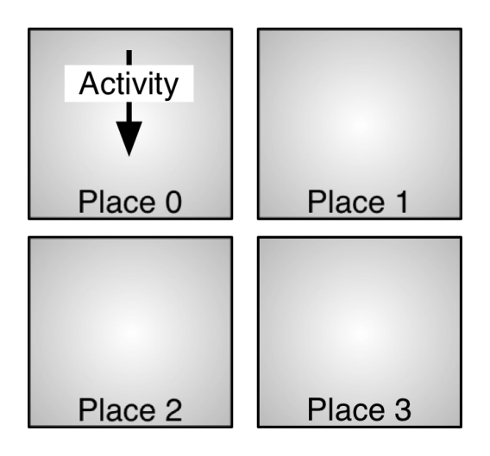
Parallelism in X10
Activities
All X10 programs begin with a single activity executing main in place 0
Create/control with at, async, finish, atomic (and many others!)
Places hold activities and objects
class x10.lang.Place
Number of places fixed at launch time, available at Place.MAX_PLACES
Place.FIRST_PLACE is place 0
Launch an X10 app with mpirun
mpirun –np 4 HelloWholeWorld
Places numbered 0..3

Slide 73
async
async S
Creates a new child activity that evaluates expression S asynchronously
Evaluation returns immediately
S may reference vals in enclosing blocks
Activities cannot be named
Activity cannot be aborted or cancelled
Stmt ::= async(p,l) Stmt
cf Cilk’s spawn
// Compute the Fibonacci
// sequence in parallel.
def run() {
if (r < 2) return;
val f1 = new Fib(r-1),
val f2 = new Fib(r-2);
finish {
async f1.run();
async f2.run();
}
r = f1.r + f2.r;
}
How many activity in different running Step(time)?
Based on “An Overview of X10 2.0”, SC09 Tutorial

Slide 74
finish
L: finish S
Evaluate S, but wait until all (transitively) spawned asyncs have terminated.
implicit finish at main activity
finish is useful for expressing
“synchronous” operations on
(local or) remote data.
Stmt ::= finish Stmt
cf Cilk’s sync
// Compute the Fibonacci
// sequence in parallel.
def run() {
if (r < 2) return;
val f1 = new Fib(r-1),
val f2 = new Fib(r-2);
finish {
async f1.run();
async f2.run();
}
r = f1.r + f2.r;
}
Notes:
Barrier
PPoPP: Vijay – fix memory model reference.
传递的；可递的

Slide 75
at
at(p) S
Evaluate expression S at place p
Parent activity is blocked until S completes
Can be used to
Read remote value
Write remote value
Invoke method on remote object
As of X10 2.1.0, manipulating objects between places requires a GlobalRef (more on that next module)
Stmt ::= at(p) Stmt
// Copy field f from a to b
// a and b are GlobalRefs
def copyRemoteFields(a, b) {
at (b.home) b.f =
at (a.home) a.f;
}
// Invoke method m on obj
// m is a GlobalRef
def invoke(obj, arg) {
at (obj.home) obj().m(arg);
}

Slide 76
atomic
atomic S
Evaluate expression S atomically
Atomic blocks are conceptually executed in a single step while other activities are suspended: isolation and atomicity.
An atomic block body (S) ...
must be nonblocking
must not create concurrent activities (sequential)
must not access remote data (local)
Stmt ::= atomic Statement
MethodModifier ::= atomic
// target defined in lexically
// enclosing scope.
atomic def CAS(old:Object, n:Object) {
if (target.equals(old)) {
target = n;
return true;
}
return false;
}
// push data onto concurrent // list-stack val node = new Node(data); atomic { node.next = head; head = node; }
Notes:
目标定义在词汇方面封闭范围

Slide 77
Single Place Example
Monte Carlo approximation of π
Algorithm
Consider a circle of radius 1
Let N = some large number (say 10000) and count = 0
Repeat the following procedure N times
Generate two random numbers x and y between 0 and 1 (use the rand function)
Check whether (x,y) lie inside the circle
Increment count if they do
Pi ≈ 4 * count / N

Slide 78
Pi Approximation
public class AsyncPi {
public static def main(s: Array[String](!)):Void {
val samplesPerActivity = 10000;
val numActivities = 8;
val activityCounts = new Array[Double](1..numActivities, (Point)=>0.0);
finish for (activityID in 1..numActivities) {
async {
val [ActivityIndex] = activityID;
val r = new Random(activityIndex);
for (i in 1..samplesPerActivity) {
val x = r.nextDouble();
val y = r.nextDouble();
val z = x*x+y*y;
if ((x*x + y*y) <= 1.0) {
activityCounts(activityID)++;
}
}
}
}
var globalCount:Double = 0.0;
for (activityID in 1..numActivities) {
globalCount += activityCounts(activityID);
}
val pi = 4*(globalCount/(samplesPerActivity*numActivities as Double));
Console.OUT.println("With ”+<snip>+" points, the value of pi is " + pi);
}
}
Notes:
Array element per activity to hold count
Async creates activities, finish for control
Individual totals added up by main activity

Slide 79
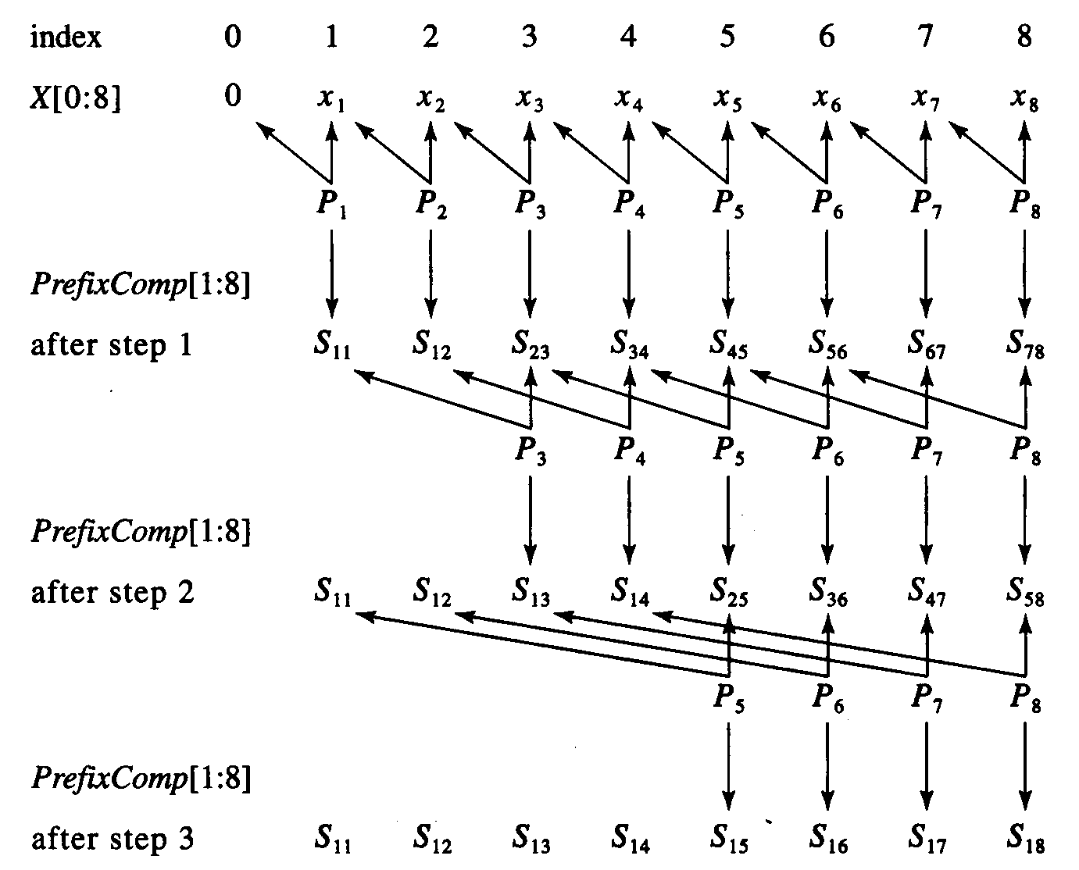
Prefix Sum: Shared Memory Algorithm
Implemented in X10 using a single place
Use doubling technique (similar to tree-based reduction). Log₂(n) steps, where
Step 1: All i>1, a[i] = a[i] + a[i-1]
Step 2: All i>2, a[i] = a[i] + a[i-2]
Step 3: All i>4, a[i] = a[i] + a[i-4], and so on…
1 | 2 | 3 | 4 | 5 | 6 | 7 | 8
1 | 3 | 5 | 7 | 9 | 11 | 13 | 15
1 | 3 | 6 | 10 | 14 | 18 | 22 | 26
1 | 3 | 6 | 10 | 15 | 21 | 28 | 36
Notes:
This is adapted from the PRAM algorithm for prefix sum
一、先讨论在PRAM上的Prefix Sum算法，使得所需时间为log n，算法示意图如下：
符号 a b 表示结点a将数据送往结点b，做加法，结果保留在b。以n=8为例。
。
a1 a2 a3 a4 a5 a6 a7 a8
S1
。 。 。 。 stage1
S2
。 。 。 。 stage2
S3 S4
。 。 。 。 stage3
S5 S6 S7 S8

Slide 80
AsyncPrefixSum class inherits from PrefixSum
Only have to update computeSum method!
public def computeSum()
{
val chunkSize = 4;
val tempArray = new Array[Int](1..prefixSumArray.size(), (Point)=>0);
val numSteps = <snip> as Int;
for ([stepNumber] in 1..numSteps) {
val stepWidth = Math.pow(2, (stepNumber - 1)) as Int;
val numActivities = Math.ceil(numChunks) as Int;
Console.OUT.println("numActivities = "+numActivities);
finish {
for ([activityId] in 1..numActivities) {
async {
for ((j) in low..hi) {
tempArray(j) = prefixSumArray(j) + prefixSumArray(j-stepWidth);
} //for j
} //async
} //for activityId
} //finish
Example parallel implementation (not the best, but illustrative…)
Fixed chunk size
At each step, spawn an activity to update each chunk
tempArray used to avoid race conditions
Copied back to prefixSumArray at end of each step
Notes:
Compute the number of steps (log2 of array length)
Compute number of chunks (remaining array length / chunk size)
Next step – efficient single-place programs by demonstrating how to make a barrier using the clock command in order to reduce the number of activities created

Slide 81
Conclusion
Activities and places
async, finish, at, atomic
Examples of single place programs
Pi approximation
Prefix Sum

Slide 82
Module 4: X10 Places and DistArrays
Notes:
82

Slide 83
Module Overview
Parallel Hello and Place objects
Referencing objects in different places
DistArrays (distributed arrays)
Distributed memory (multi-place) Prefix Sum

Slide 84
Parallel Hello
class HelloWholeWorld {
public static def main(args:Array[String](1)):void {
for (var i:Int=0; i<Place.MAX_PLACES; i++) {
val iVal = i;
async at (Place.places(iVal)) {
Console.OUT.println("Hello World from place "+here.id);
}
}
}
}
Hello World from place 0
Hello World from place 2
Hello World from place 3
Hello World from place 1
at – place shift
Shift current activity to a place to evaluate an expression, then return
Copy necessary values from calling place to callee place, discard when done
async
start new activity and don’t wait for it to complete
async and at should be thought of as executing via closure
We bundle up the values referenced in its code and create an anonymous function (in at statement, the bundle is copied to the other place!)
Can’t reference external var in async or at, only val
For example, iVal is a val copy of i for use in at. i is a var and would generate an error
Notes:
At场所转换
Note that async at != at async
第四节 匿名函数及闭包
匿名函数在编程语言中出现的比较早，最早出现在Lisp语言中，随后很多的编程语言都开始有这个功能了， 目前使用比较广泛的Javascript以及C#，PHP直到5.3才开始真正支持匿名函数，C++的新标准C++0x也开始支持了。
匿名函数是一类不需要指定标示符，而又可以被调用的函数或子例程，匿名函数可以方便的作为参数传递给其他函数， 最常见应用是作为回调函数。
闭包(Closure)
说到匿名函数，就不得不提到闭包了，闭包是词法闭包(Lexical Closure)的简称，是引用了自由变量的函数， 这个被应用的自由变量将和这个函数一同存在，即使离开了创建它的环境也一样，所以闭包也可认为是有函数和与其相关引用组合而成的实体。 在一些语言中，在函数内定义另一个函数的时候，如果内部函数引用到外部函数的变量，则可能产生闭包。在运行外部函数时， 一个闭包就形成了。
这个词和匿名函数很容易被混用，其实这是两个不同的概念，这可能是因为很多语言实现匿名函数的时候允许形成闭包。
闭包是可以包含自由（未绑定到特定对象）变量的代码块；这些变量不是在这个代码块内或者任何全局上下文中定义的，而是在定义代码块的环境中定义。“闭包” 一词来源于以下两者的结合：要执行的代码块（由于自由变量被包含在代码块中，这些自由变量以及它们引用的对象没有被释放）和为自由变量提供绑定的计算环境（作用域）。

Slide 85
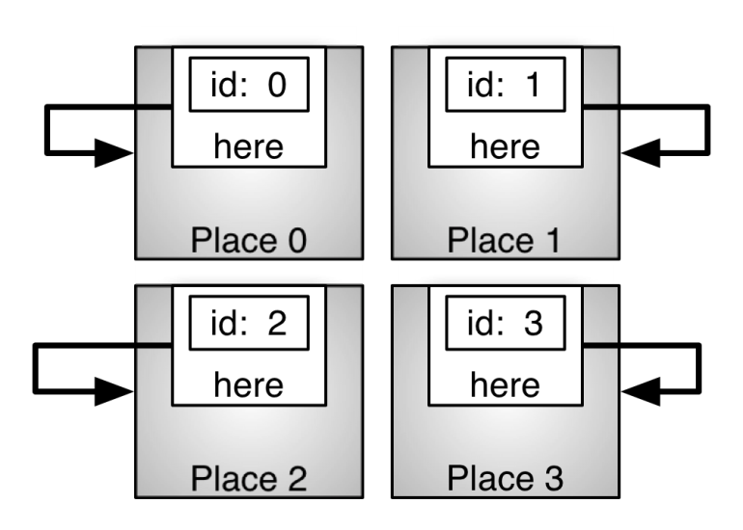
Place Objects
class HelloWholeWorld {
public static def main(args:Array[String](1)):void {
for (var i:Int=0; i<Place.MAX_PLACES; i++) {
val iVal = i;
async at (Place.places(iVal)) {
Console.OUT.println("Hello World from place "+here.id);
}
}
}
}
Hello World from place 0
Hello World from place 2
Hello World from place 3
Hello World from place 1
Place objects have a field called id that contains the place number
here – Place object always bound to current place
Notes:
javascript深入理解js闭包
闭包（closure）是Javascript语言的一个难点，也是它的特色，很多高级应用都要依靠闭包实现。
一、变量的作用域
要理解闭包，首先必须理解Javascript特殊的变量作用域。
变量的作用域无非就是两种：全局变量和局部变量。
Javascript语言的特殊之处，就在于函数内部可以直接读取全局变量。
Js代码
var n=999;
function f1(){
alert(n);
}
f1(); // 999
另一方面，在函数外部自然无法读取函数内的局部变量。
Js代码
function f1(){
var n=999;
}
alert(n); // error
这里有一个地方需要注意，函数内部声明变量的时候，一定要使用var命令。如果不用的话，你实际上声明了一个全局变量！
Js代码
function f1(){
n=999;
}
f1();
alert(n); // 999
--------------------------------------------------------------------------------------------------------
二、如何从外部读取局部变量？
出于种种原因，我们有时候需要得到函数内的局部变量。但是，前面已经说过了，正常情况下，这是办不到的，只有通过变通方法才能实现。
那就是在函数的内部，再定义一个函数。
Js代码
function f1(){
n=999;
function f2(){
alert(n); // 999
}
}
在上面的代码中，函数f2就被包括在函数f1内部，这时f1内部的所有局部变量，对f2都是可见的。但是反过来就不行，f2内部的局部变量，对f1 就是不可见的。这就是Javascript语言特有的“链式作用域”结构（chain scope），
子对象会一级一级地向上寻找所有父对象的变量。所以，父对象的所有变量，对子对象都是可见的，反之则不成立。
既然f2可以读取f1中的局部变量，那么只要把f2作为返回值，我们不就可以在f1外部读取它的内部变量了吗！
Js代码
function f1(){
n=999;
function f2(){
alert(n);
}
return f2;
}
var result=f1();
result(); // 999
--------------------------------------------------------------------------------------------------------
三、闭包的概念
上一节代码中的f2函数，就是闭包。
各种专业文献上的“闭包”（closure）定义非常抽象，很难看懂。我的理解是，闭包就是能够读取其他函数内部变量的函数。
由于在Javascript语言中，只有函数内部的子函数才能读取局部变量，因此可以把闭包简单理解成“定义在一个函数内部的函数”。
所以，在本质上，闭包就是将函数内部和函数外部连接起来的一座桥梁。
--------------------------------------------------------------------------------------------------------b
四、闭包的用途
闭包可以用在许多地方。它的最大用处有两个，一个是前面提到的可以读取函数内部的变量，另一个就是让这些变量的值始终保持在内存中。
怎么来理解这句话呢？请看下面的代码。
Js代码
function f1(){
var n=999;
nAdd=function(){n+=1}
function f2(){
alert(n);
}
return f2;
}
var result=f1();
result(); // 999
nAdd();
result(); // 1000
在这段代码中，result实际上就是闭包f2函数。它一共运行了两次，第一次的值是999，第二次的值是1000。这证明了，函数f1中的局部变量n一直保存在内存中，并没有在f1调用后被自动清除。
为什么会这样呢？原因就在于f1是f2的父函数，而f2被赋给了一个全局变量，这导致f2始终在内存中，而f2的存在依赖于f1，因此f1也始终在内存中，不会在调用结束后，被垃圾回收机制（garbage collection）回收。
这段代码中另一个值得注意的地方，就是“nAdd=function(){n+=1}”这一行，首先在nAdd前面没有使用var关键字，因此 nAdd是一个全局变量，而不是局部变量。其次，nAdd的值是一个匿名函数（anonymous function），而这个
匿名函数本身也是一个闭包，所以nAdd相当于是一个setter，可以在函数外部对函数内部的局部变量进行操作。
--------------------------------------------------------------------------------------------------------
五、使用闭包的注意点
1）由于闭包会使得函数中的变量都被保存在内存中，内存消耗很大，所以不能滥用闭包，否则会造成网页的性能问题，在IE中可能导致内存泄露。解决方法是，在退出函数之前，将不使用的局部变量全部删除。
2）闭包会在父函数外部，改变父函数内部变量的值。所以，如果你把父函数当作对象（object）使用，把闭包当作它的公用方法（Public Method），把内部变量当作它的私有属性（private value），这时一定要小心，不要随便
改变父函数内部变量的值。
--------------------------------------------------------------------------------------------------------
六、思考题
如果你能理解下面代码的运行结果，应该就算理解闭包的运行机制了。
Js代码
var name = "The Window";
var object = {
name : "My Object",
getNameFunc : function(){
return function(){
return this.name;
};
}
};
alert(object.getNameFunc()()); //The Window
--------------------------------------------------------------------------------------------------------
JavaScript闭包例子
function outerFun()
{
var a=0;
function innerFun()
{
a++;
alert(a);
}
}
innerFun()
上面的代码是错误的.innerFun()的作用域在outerFun()内部,所在outerFun()外部调用它是错误的.
改成如下,也就是闭包:
Js代码
function outerFun()
{
var a=0;
function innerFun()
{
a++;
alert(a);
}
return innerFun; //注意这里
}
var obj=outerFun();
obj(); //结果为1
obj(); //结果为2
var obj2=outerFun();
obj2(); //结果为1
obj2(); //结果为2
什么是闭包:
当内部函数 在定义它的作用域 的外部 被引用时,就创建了该内部函数的闭包 ,如果内部函数引用了位于外部函数的变量,当外部函数调用完毕后,这些变量在内存不会被 释放,因为闭包需要它们.
--------------------------------------------------------------------------------------------------------
再来看一个例子
Js代码
function outerFun()
{
var a =0;
alert(a);
}
var a=4;
outerFun();
alert(a);
结果是 0,4 . 因为在函数内部使用了var关键字 维护a的作用域在outFun()内部.
再看下面的代码:
Js代码
function outerFun()
{
//没有var
a =0;
alert(a);
}
var a=4;
outerFun();
alert(a);
结果为 0,0 真是奇怪,为什么呢?
作用域链是描述一种路径的术语,沿着该路径可以确定变量的值 .当执行a=0时,因为没有使用var关键字,因此赋值操作会沿着作用域链到var a=4; 并改变其值.
--------------------------------------------------------------------------------------------------------------------------------------------------
如果你对javascript闭包还不是很理解，那么请看下面转载的文章：(转载:http://www.felixwoo.com/archives/247)
一、什么是闭包？
官方”的解释是：闭包是一个拥有许多变量和绑定了这些变量的环境的表达式（通常是一个函数），因而这些变量也是该表达式的一部分。
相信很少有人能直接看懂这句话，因为他描述的太学术。其实这句话通俗的来说就是：JavaScript中所有的function都是一个闭包。不过一般来说，嵌套的function所产生的闭包更为强大，也是大部分时候我们所谓的“闭包”。看下面这段代码：
function a() {
var i = 0;
function b() { alert(++i); }
return b;
}
var c = a();
c();
这段代码有两个特点：
1、函数b嵌套在函数a内部；
2、函数a返回函数b。
引用关系如图：
这样在执行完var c=a()后，变量c实际上是指向了函数b，再执行c()后就会弹出一个窗口显示i的值(第一次为1)。这段代码其实就创建了一个闭包，为什么？因为函数a外的变量c引用了函数a内的函数b，就是说：
当函数a的内部函数b被函数a外的一个变量引用的时候，就创建了一个闭包。
让我们说的更透彻一些。所谓“闭包”，就是在构造函数体内定义另外的函数作为目标对象的方法函数，而这个对象的方法函数反过来引用外层函数体中的临时变量。这使得只要目标 对象在生存期内始终能保持其方法，就能间接保持原构造函数体当时用到的临时变量值。尽管最开始的构造函数调用已经结束，临时变量的名称也都消失了，但在目 标对象的方法内却始终能引用到该变量的值，而且该值只能通这种方法来访问。即使再次调用相同的构造函数，但只会生成新对象和方法，新的临时变量只是对应新 的值，和上次那次调用的是各自独立的。
二、闭包有什么作用？
简而言之，闭包的作用就是在a执行完并返回后，闭包使得Javascript的垃圾回收机制GC不会收回a所占用的资源，因为a的内部函数b的执行需要依赖a中的变量。这是对闭包作用的非常直白的描述，不专业也不严谨，但大概意思就是这样，理解闭包需要循序渐进的过程。
在上面的例子中，由于闭包的存在使得函数a返回后，a中的i始终存在，这样每次执行c()，i都是自加1后alert出i的值。
那 么我们来想象另一种情况，如果a返回的不是函数b，情况就完全不同了。因为a执行完后，b没有被返回给a的外界，只是被a所引用，而此时a也只会被b引 用，因此函数a和b互相引用但又不被外界打扰(被外界引用)，函数a和b就会被GC回收。(关于Javascript的垃圾回收机制将在后面详细介绍)
三、闭包内的微观世界
如果要更加深入的了解闭包以及函数a和嵌套函数b的关系，我们需要引入另外几个概念：函数的执行环境(excution context)、活动对象(call object)、作用域(scope)、作用域链(scope chain)。以函数a从定义到执行的过程为例阐述这几个概念。
1. 当定义函数a的时候，js解释器会将函数a的作用域链(scope chain)设置为定义a时a所在的“环境”，如果a是一个全局函数，则scope chain中只有window对象。
2. 当执行函数a的时候，a会进入相应的执行环境(excution context)。
3. 在创建执行环境的过程中，首先会为a添加一个scope属性，即a的作用域，其值就为第1步中的scope chain。即a.scope=a的作用域链。
4. 然后执行环境会创建一个活动对象(call object)。活动对象也是一个拥有属性的对象，但它不具有原型而且不能通过JavaScript代码直接访问。创建完活动对象后，把活动对象添加到a的作用域链的最顶端。此时a的作用域链包含了两个对象：a的活动对象和window对象。
5. 下一步是在活动对象上添加一个arguments属性，它保存着调用函数a时所传递的参数。
6. 最后把所有函数a的形参和内部的函数b的引用也添加到a的活动对象上。在这一步中，完成了函数b的的定义，因此如同第3步，函数b的作用域链被设置为b所被定义的环境，即a的作用域。
到此，整个函数a从定义到执行的步骤就完成了。此时a返回函数b的引用给c，又函数b的作用域链包含了对函数a的活动对象的引用，也就是说b可以访问到a中定义的所有变量和函数。函数b被c引用，函数b又依赖函数a，因此函数a在返回后不会被GC回收。
当函数b执行的时候亦会像以上步骤一样。因此，执行时b的作用域链包含了3个对象：b的活动对象、a的活动对象和window对象，如下图所示：
如图所示，当在函数b中访问一个变量的时候，搜索顺序是：
1. 先搜索自身的活动对象，如果存在则返回，如果不存在将继续搜索函数a的活动对象，依次查找，直到找到为止。
2. 如果函数b存在prototype原型对象，则在查找完自身的活动对象后先查找自身的原型对象，再继续查找。这就是Javascript中的变量查找机制。
3. 如果整个作用域链上都无法找到，则返回undefined。
小结，本段中提到了两个重要的词语：函数的定义与执行。文中提到函数的作用域是在定义函数时候就已经确定，而不是在执行的时候确定（参看步骤1和3）。用一段代码来说明这个问题：
function f(x) {
var g = function () { return x; }
return g;
}
var h = f(1);
alert(h());
这段代码中变量h指向了f中的那个匿名函数(由g返回)。
• 假设函数h的作用域是在执行alert(h())确定的，那么此时h的作用域链是：h的活动对象->alert的活动对象->window对象。
• 假设函数h的作用域是在定义时确定的，就是说h指向的那个匿名函数在定义的时候就已经确定了作用域。那么在执行的时候，h的作用域链为：h的活动对象->f的活动对象->window对象。
如果第一种假设成立，那输出值就是undefined；如果第二种假设成立，输出值则为1。
运行结果证明了第2个假设是正确的，说明函数的作用域确实是在定义这个函数的时候就已经确定了。
四、闭包的应用场景
保护函数内的变量安全。以最开始的例子为例，函数a中i只有函数b才能访问，而无法通过其他途径访问到，因此保护了i的安全性。
1. 在内存中维持一个变量。依然如前例，由于闭包，函数a中i的一直存在于内存中，因此每次执行c()，都会给i自加1。
2. 通过保护变量的安全实现JS私有属性和私有方法（不能被外部访问）
私有属性和方法在Constructor外是无法被访问的
function Constructor(...) {
var that = this;
var membername = value;
function membername(...) {...}
}
以上3点是闭包最基本的应用场景，很多经典案例都源于此。
五、Javascript的垃圾回收机制
在Javascript中，如果一个对象不再被引用，那么这个对象就会被GC回收。如果两个对象互相引用，而不再被第3者所引用，那么这两个互相引用的对象也会被回收。因为函数a被b引用，b又被a外的c引用，这就是为什么函数a执行后不会被回收的原因。
六、结语
理解JavaScript的闭包是迈向高级JS程序员的必经之路，理解了其解释和运行机制才能写出更为安全和优雅的代码。

Slide 86
Objects (Review from Module 2)
class Driver {
public static def main(args:Array[String](1)):Void {
val firstCounter = new Counter();
val secondCounter = new Counter(5);
for (var i:Int=0; i<10; i++) {
firstCounter.count();
secondCounter.count();
}
val firstValue = firstCounter.getCount();
val secondValue = secondCounter.getCount();
Console.OUT.println("First value = "+firstValue);
Console.OUT.println("Second value = "+secondValue);
}
}
Object instantiation with new
firstCounter uses default constructor, secondCounter uses initialization constructor
X10 has garbage collection, so no malloc/free. Object GC’ed when it leaves scope
Notes:
Review from module 2.
GC’ed=garbage collection

Slide 87
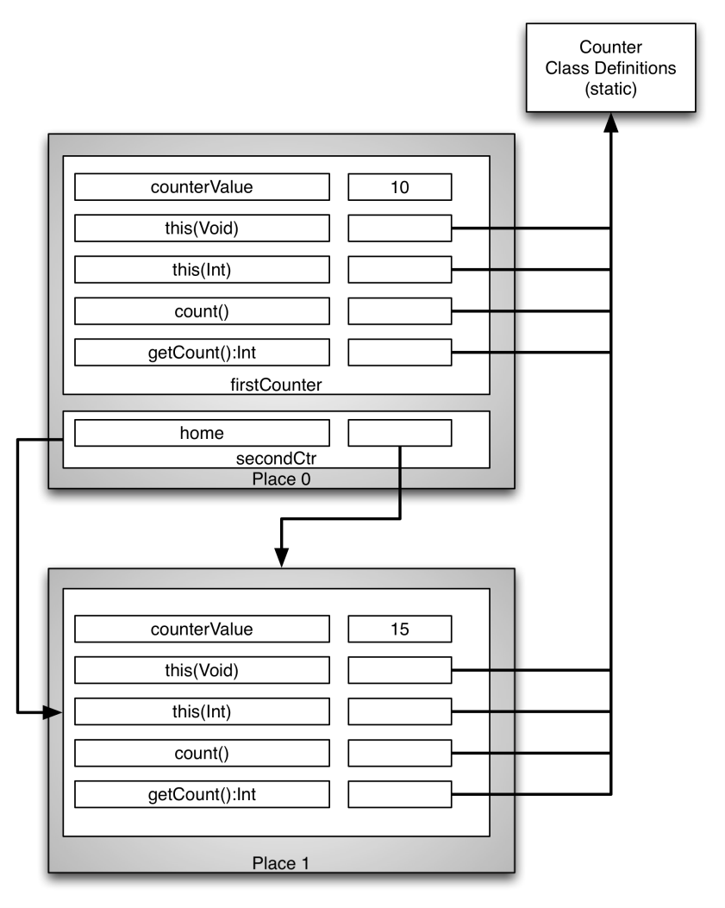
Objects in Places
public static def main(args:Array[String](1)):Void {
val secondCtr = (at (Place.places(1)) GlobalRef[Counter](new Counter(5)));
for (var i:Int=0; i<10; i++) {
at (secondCtr.home) {
secondCtr().count();
}
}
val secondValue = (at (secondCtr.home) secondCtr().getCount());
Console.OUT.println("Second value = "+secondValue);
}
Objects instantiated in a place
Access objects across places via global references
secondCtr example
Object at Place 1, GlobalRef at Place 0
GlobalRef object, say g
Contains home member: place where original object is instantiated
Contains a serialized reference to the original object
Supplies reference to original object through g.apply() method, often abbreviated g()
g.apply() can only be called when g.home == here
Notes:
The X10 struct type GlobalRef is a reference to an object at one place that may
be passed to other places. GlobalRef can be used to build arbitrary distributed
data structures.

Slide 88
Array and DistArray
A Point is an element of an n-dimensional Cartesian space (n>=1) with integer-valued coordinates e.g., [5], [1, 2], …
A Region is an ordered set of points, all of the same rank
An Array maps every Point in its defining Region to a corresponding data element.
Key operations
creation
apply/set (read/write elements)
map, reduce, scan
iteration, enhanced for loops
copy
A Dist (distribution) maps every Point in its Region to a Place
A DistArray (distributed array) is defined over a Dist and maps every Point in its distribution to a corresponding data element.
Data elements in the DistArray may only be accessed in their home location (the place to which the Dist maps their Point)
Key operations similar to Array, but bulk operations (map, reduce, etc) are distributed operations
With the exception of Array literals ( [1, 2, 3] === new Array[int](3,(i:int)=>i+1) ), Array and DistArray are implemented completely as library classes in the x10.array package with no special compiler support.
Notes:
with the exception 报错
除了…情况

Slide 89
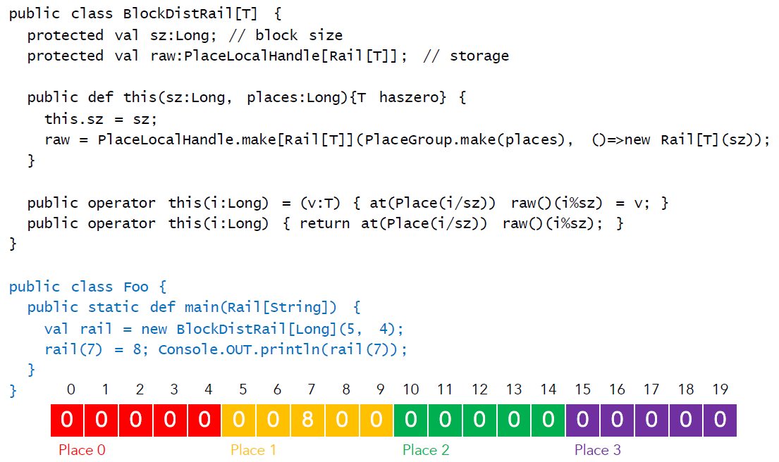
Block Dist Rail

Slide 90
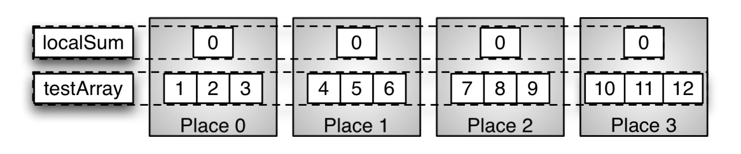
DistArray
public static def main(args:Array[String](1)):Void {
val arraySize = 12;
val R : Region = 1..arraySize;
show("Dist.makeUnique() ", Dist.makeUnique());
show("Dist.makeBlock(R) ", Dist.makeBlock(R));
show("Dist.makeBlock(R)|here", Dist.makeBlock(R)|here);
val testArray = DistArray.make[Int](Dist.makeBlock(R), ([i]:Point)=>i);
val localSum = DistArray.make[Int](Dist.makeUnique(), ((Point)=>0));
dhudak@dhudak-macbook-pro 47%> mpirun -np 4 Driver
Dist.makeUnique() = 0 1 2 3
Dist.makeBlock(R) = 0 0 0 1 1 1 2 2 2 3 3 3
Dist.makeBlock(R)|here = 0 0 0
Notes:
Why did Dist.makeBlock(R)|here return 0 0 0 0? Because main’s activity is running in place 0, so “here” means place 0.

Slide 91
DistArray Example
def addTo(a:DistArray[Int], b:DistArray[Int])
{a.dist == b.dist} = {
for (p in a.dist) {
at (a.dist(p)) {
a(p) += b(p);
}
}
}
val R = 0..N;
val D = Dist.makeBlock();
val A = DistArray.make[Int] (D, …);
addTo(A, A);
R is a Region
D is a ‘blocked’ distribution

Slide 92
DistArray Explained
Region
(x1)
(x3)
1
3
Y
(x2,y2)
Y
(x2,y2)
(x1,y1)
(x1,y1)
X
X
Places
(a,b,c))
(a,b,c))
Y
Z
Y
Z
val d = Dist.makeUnique()
val d = Dist.makeBlock(r,b)
Val d = Dist.makeCyclic(r,d)
b
c
a
X
X
Point
Used as subscripts
A(i), B(i,j), D(,j,k)
Region
Acceptable subscripts
i..j, (1,1,1)*(2,2,3)
Dist
Where is a(i) placed?
Unique, Block, Cyclic?

Slide 93
Distributions map regions to places
Dist factory methods – makeUnique, makeBlock
Cyclic, block-cyclic distributions also supported
Dist (and range) restrictions using | operator
DistArray similar to Array instantiation
Dist object must be provided in addition to base type and initialization function
DistArray name is visible at all places

Slide 94

DistArray Example
Let’s compute the global sum of testArray
Step 1: sum the subarray at each place
Every DistArray object has a member called dist
Every dist object has a method called places that returns an Array of Place objects
Create an activity at each place using async
Step 2: main activity at place 0
retrieves local sum from each place and adds them together
Notes:
Remember from last module – every place object has a member called id that stores the place number.

Slide 95
DistArray Example
finish {
for (p in testArray.dist.places()) {
async at (p) {
for (localPoint in testArray|here) {
localSum(p.id) += testArray(localPoint);
}
}
}
}
var globalSum:Int = 0;
for (p in localSum.dist.places()) {
globalSum += (at (p) localSum(p.id));
}
}
Notes:
Remember from last module – every place object has a member called id that stores the place number.

Slide 96
DistArray of Objects
val counterArray = DistArray.make[Counter](Dist.makeUnique());
val counterArrayPlaces = counterArray.dist.places();
for (p in counterArrayPlaces) {
at (p) {
counterArray(p.id) = new Counter(p.id);
}
}
for (p in counterArrayPlaces) {
at (p) {
val myCounter = counterArray(p.id);
val myCounterValue = myCounter.getCount();
Console.OUT.println("Start "+p.id+": myCounter = "+myCounterValue);
}
}
Allocate a DistArray of Counters
Iterate over all places of the DistArray, constructing a Counter object at each place

Slide 97
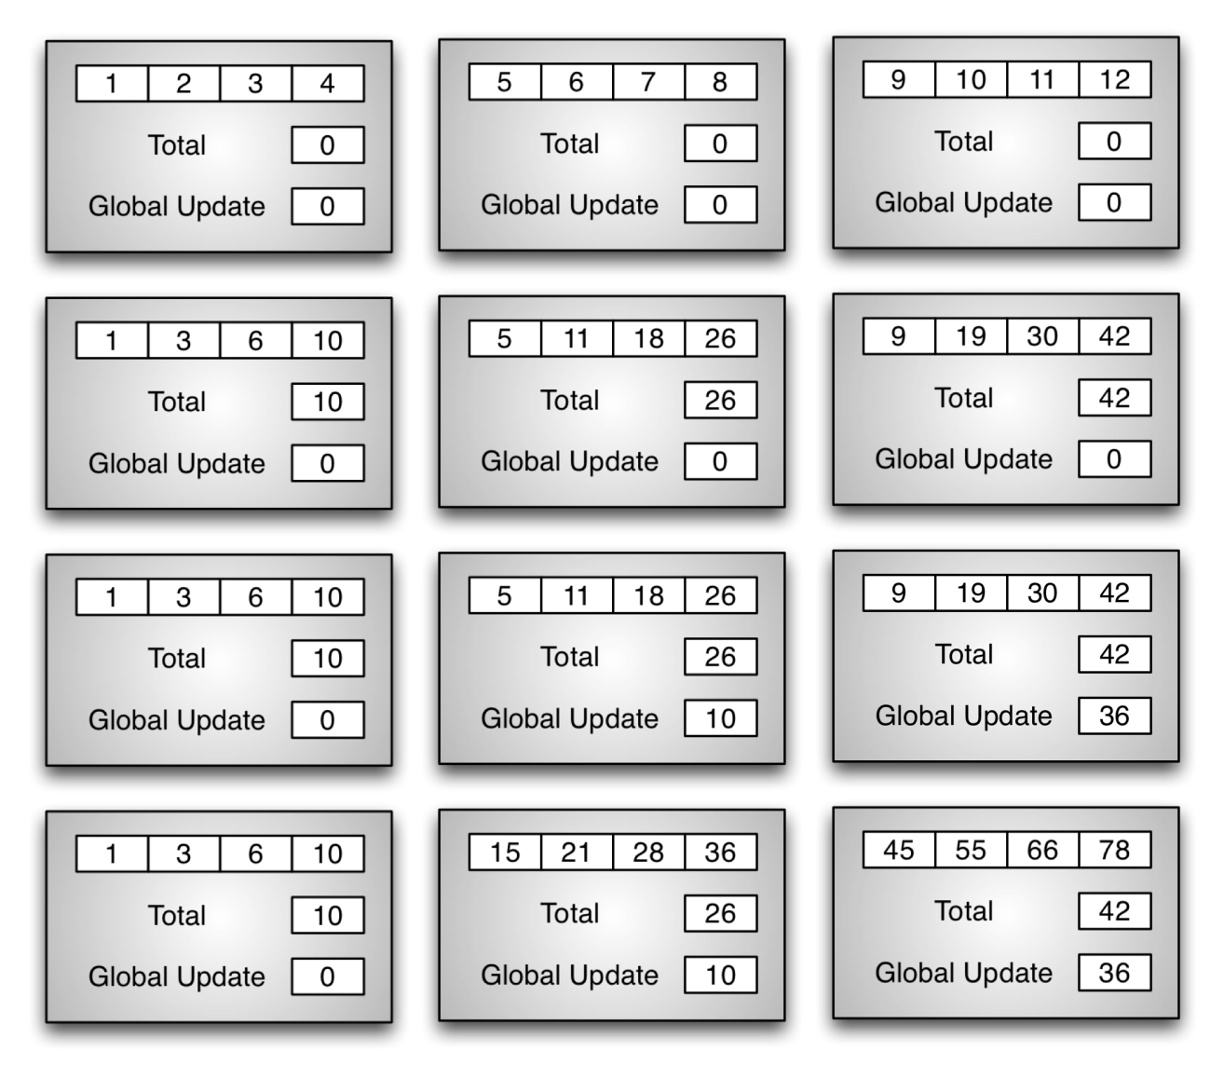
Prefix Sum: Distributed Memory Algorithm
Step 1: compute prefix sum and total at each place
Step 2: each place calculates its global update (sum of preceding totals)
Step 3: each place updates its elements with its global update
Notes:
Global update – sum of totals from preceding places

Slide 98
Step 1
public def computeSum()
{
finish {
for (p in prefixSumArray.dist.places()) {
async at (p) {
localSums(here.id) = 0;
var first : Boolean = true;
for ([i] in prefixSumArray|here) {
localSums(here.id) += prefixSumArray(i);
if (first) {
first = false;
}
else {
prefixSumArray(i) = prefixSumArray(i) + prefixSumArray(i-1);
}
} //for i
} //at
Step 1 – compute prefix sum (and total) at each place
Two distributed arrays in object, prefixSumArray and localSums

Slide 99
Steps 2 and 3
finish {
for (p in prefixSumArray.dist.places()) {
async at (p) {
val placeId = here.id;
var globalUpdate: Int = 0;
for (var j:Int=0;j<placeId;j++) {
val valj = j;
globalUpdate += (at (Place.places()(valj)) localSums(here.id));
}
for ((i) in prefixSumArray.dist|here) {
prefixSumArray(i) += globalUpdate;
} //for i
Step 2 – calculate global offset
Place 3 needs to add totals from Place 0, 1 and 2
Place.places methods used to obtain place
at expression retrieves value
valj needed for closure created at expression
Step 3 – update array with global offset

Slide 100
Conclusion
Place objects and here for multi-place programming
Global references
Distributions map regions to places
DistArray construction and access
Distributed Prefix Sum algorithm

Slide 101
Hello Whole World
import x10.io.Console;
class HelloWholeWorld {
public static def main(Array[String]) {
finish for (p in Place.places()) {
async at (p)
Console.OUT.println("Hello World from place" +p.id);
}
}
}
(%1) x10c++ -o HelloWholeWorld -O HelloWholeWorld.x10
(%2) runx10 -n 4 HelloWholeWorld
Hello World from place 0
Hello World from place 2
Hello World from place 3
Hello World from place 1
(%3)

Slide 102
Sequential MontyPi
import x10.io.Console;
import x10.util.Random;
class MontyPi {
public static def main(args:Array[String](1)) {
val N = Int.parse(args(0));
val r = new Random();
var result:Double = 0;
for (1..N) {
val x = r.nextDouble();
val y = r.nextDouble();
if (x*x + y*y <= 1) result++;
}
val pi = 4*result/N;
Console.OUT.println(“The value of pi is “ + pi);
}
}

Slide 103
Concurrent MontyPi
import x10.io.Console;
import x10.util.Random;
class MontyPi {
public static def main(args:Array[String](1)) {
val N = Int.parse(args(0));
val P = Int.parse(args(1));
val result = new Cell[Double](0);
finish for (1..P) async {
val r = new Random();
var myResult:Double = 0;
for (1..(N/P)) {
val x = r.nextDouble();
val y = r.nextDouble();
if (x*x + y*y <= 1) myResult++;
}
atomic result() += myResult;
}
val pi = 4*(result())/N;
Console.OUT.println(“The value of pi is “ + pi);
}
}

Slide 104
Distributed MontyPi
import x10.io.Console;
import x10.util.Random;
class MontyPi {
public static def main(args:Array[String](1)) {
val N = Int.parse(args(0));
val result = GlobalRef[Cell[Double]](new Cell[Double](0));
finish for (p in Place.places()) at (p) async {
val r = new Random();
var myResult:Double = 0;
for (1..(N/Place.MAX_PLACES)) {
val x = r.nextDouble();
val y = r.nextDouble();
if (x*x + y*y <= 1) myResult++;
}
val ans = myResult;
at (result) atomic result()() += ans;
}
val pi = 4*(result()())/N;
Console.OUT.println(“The value of pi is “ + pi);
}
}

Slide 105
Sequential Quicksort (1)
import x10.io.Console;
import x10.util.Random;
class QuickSort {
public static def main(args:Array[String](1)) {
val N = args.size>0 ? Int.parse(args(0)) : 100;
val r = new x10.util.Random();
val data = new Array[int](N, (int)=>r.nextInt(9999));
qsort(data, 0, N-1);
for ([i] in 0..N-1) {
Console.OUT.print(data(i));
if (i%10 == 9) {
Console.OUT.println();
} else {
Console.OUT.print(", ");
}
}
Console.OUT.println();
}

Slide 106
Sequential Quicksort (2)
static def qsort(data:Array[int](1), left:int, right:int) {
val index:int = partition(data, left, right);
if (left < index - 1)
qsort(data, left, index - 1);
if (index < right)
qsort(data, index, right);
}

Slide 107
Sequential Quicksort (3)
private static def partition(data:Array[int](1), left:int, right:int){
var i:int = left;
var j:int = right;
var tmp:int;
val pivot = data((left + right) / 2);
while (i <= j) {
while (data(i) < pivot) i++;
while (data(j) > pivot) j--;
if (i <= j) {
tmp = data(i);
data(i) = data(j);
data(j) = tmp;
i++;
j--;
}
}
return i;
}
Notes:
private static def partition(data:Array[int](1), left:int, right:int){
var i:int = left;
var j:int = right;
var tmp:int;
val pivot = data((left + right) / 2);
while (i <= j) {
while (data(i) < pivot) i++;
while (data(j) > pivot) j--;
if (i <= j) {
tmp = data(i);
data(i) = data(j);
data(j) = tmp;
i++;
j--;
}
}
return i;
}

Slide 108
Parallel Quicksort
static def qsort(data:Array[int](1), left:int, right:int) {
val index:int = partition(data, left, right);
if (left < index - 1)
qsort(data, left, index - 1);
if (index < right)
qsort(data, index, right);
}
static def qsort(data:Array[int](1), left:int, right:int) {
val index:int = partition(data, left, right);
finish {
if (left < index - 1)
async qsort(data, left, index - 1);
if (index < right)
qsort(data, index, right);
}
}

Slide 109
Module 5：Challenge and X10 Programming Model

Slide 110
Performance and Productivity Challenges
1) Memory wall: Architectures exhibit severe non-uniformities in bandwidth & latency in memory hierarchy
2) Frequency wall: Architectures introduce hierarchical heterogeneous parallelism to compensate for frequency scaling slowdown
Proc Cluster
Proc Cluster
Clusters (scale-out)
SMP
Multiple cores on a chip
Coprocessors (SPUs)
SMTs
SIMD
ILP
. . .
. . .
PEs,
L1 $
PEs,
L1 $
PEs,
L1 $
PEs,
L1 $
. . .
L2 Cache
L2 Cache
. . .
. . .
L3 Cache
. . .
Memory
3) Scalability wall: Software will need to deliver ~ 10⁵-way parallelism to utilize peta-scale parallel systems
Notes:
uniformity [,ju:ni'fɔ:məti]
基本翻译
n. 均匀性；一致；同样
Unique opportunity for software technologies to help
frequency scale
基本翻译
频标；频率刻度
网络释义
frequency scale:频标 | 频率刻度 | 频率标度
heterogeneous [,hetərəu'dʒi:njəs]
基本翻译
adj. [化学] 多相的；异种的；[化学] 不均匀的；由不同成分形成的
网络释义
heterogeneous:非均匀的 | 不均匀的 | 异质

Slide 111
High Complexity Limits Development Productivity
One billion transistors in a chip
Proc Cluster
Proc Cluster
. . .
. . .
1995: entire chip can be accessed in 1 cycle
PEs,
L1 $
PEs,
L1 $
PEs,
L1 $
PEs,
L1 $
. . .
2010: only small fraction of chip can be accessed in 1 cycle
L2 Cache
L2 Cache
. . .
\\
Major sources of complexity for application developer:
1) Severe non-uniformities in data accesses
2) Applications must exhibit large degrees of parallelism
(up to ~ 10⁵ threads)
. . .
L3 Cache
Complexity leads to increases in all phases of HPC Software Lifecycle related to parallel code
Memory
//
//
Development of Parallel Source Code ---
Design, Code,
Test, Port,
Scale, Optimize
Written
Specification
Production
Runs of
Parallel Code
Maintenance and
Porting of Parallel Code
Requirements
Algorithm
Development
Parallel Specification
Input Data
Source Code

Slide 112
A new era of mainstream parallel processing
The Challenge
Parallelism scaling replaces frequency scaling as foundation for
increased performance
➔ Profound impact on future software
Multi-core chips
Heterogeneous Parallelism
Cluster Parallelism
SMP Node
SMP Node
. . .
. . .
. . .
PEs,
L1 $
PEs,
L1 $
. . .
. . .
PEs,
PEs,
PEs,
PEs,
L2 Cache
. . .
. . .
PEs,
L1 $
PEs,
L1 $
Memory
Memory
L2 Cache
Interconnect
Notes:
Contacts: Vivek Sarkar/Watson/IBM, Vijay Saraswat/Watson/IBM
Parallelism scaling replaces frequency scaling as the foundation for increased performance. Parallelism scaling can be observed at three important levels of the hardware stack:
Multi-core parallelism
Hetreogeneous parallelism (as in the Cell processor)
Cluster parallelism as in Blue Gene or in commodity scale-out clusters
The move towards parallelism as the primary driver for system performance will have a profound software impact on software, because all software will need to be enabled to exploit parallelism. Some areas of commercial software (e.g. transaction systems) are already prepared for this trend from past investments in SMP-enablement. However, a lot of other software is predominantly single-threaded has been riding the frequency scaling curve predicted by Moore’s Law for the last two decades. The goal of the X10 project in IBM Research is to respond to this future software crisis by establishing new foundations for programming models, languages, tools, compilers, runtimes, virtual machines, and libraries for parallel hardware.
profound [prəu'faund]
基本翻译
adj. 深厚的；意义深远的；渊博的
网络释义
profound:深深感觉 | 深刻的 | 重大的

Slide 113
Profound impact on future software
The move towards parallelism as the primary driver for system performance
a profound software impact on software
because all software will need to be enabled to exploit parallelism.
Some areas of commercial software (e.g. transaction systems) are already prepared for this trend from past investments in SMP-enablement.
a lot of other software is predominantly single-threaded has been riding the frequency scaling curve predicted by Moore’s Law for the last two decades.
The goal of the X10 project in IBM Research is to respond to this future software crisis by establishing new foundations for programming models, languages, tools, compilers, runtimes, virtual machines, and libraries for parallel hardware.
Notes:
profound [prəu'faund]
基本翻译
adj. 深厚的；意义深远的；渊博的
网络释义
profound:深奥的 | 深刻的 | 极深

Slide 114
PERCS Programming Model/Tools: Overall Architecture
X10 source code
Java+Threads+Conc utils
C/C++ /MPI /OpenMP
Fortran/MPI/OpenMP)
. . .
Performance
Exploration
X10 Development Toolkit
Java Development Toolkit
C Development Toolkit
Fortran Development Toolkit
. . .
Productivity Metrics
Integrated Programming Environment: Edit, Compile, Debug, Visualize, Refactor
Use Eclipse platform (eclipse.org) as foundation for integrating tools
Morphogenic Software: separation of concerns, separation of roles
X10 Components
Java components
Fortran components
C/C++ components
Fast extern
interface
X10 runtime
Java runtime
Fortran runtime
C/C++ runtime
Integrated Concurrency Library: messages, synchronization, threads
PERCS = Productive
Easy-to-use Reliable
Computer Systems
Continuous Program Optimization (CPO)
PERCS System Software (K42)
Notes:
morphogenic [,mɔ:fəu'dʒenik]
基本翻译
adj. 地貌成因的
网络释义
morphogenic:地貌成因的

Slide 115
X10 Environment
Very High Level Languages (VHLL’s),
Domain Specific Languages (DSL’s)
Implicit parallelism,
Implicit data distributions
X10 Libraries
X10 places --- abstraction of explicit control & data distribution
X10 High Level Language
X10 Deployment
Mapping of places to nodes in HPC Parallel Environment
HPC Runtime Environment
(Parallel Environment, MPI, LAPI, …)
Primitive constructs for parallelism, communication, and synchronization
HPC Parallel System
Target system for parallel application
Notes:
primitive ['primitiv]
基本翻译
adj. 原始的，远古的；简单的，粗糙的
n. 原始人
网络释义
primitive:基元 | 原始的 | 原语

Slide 116
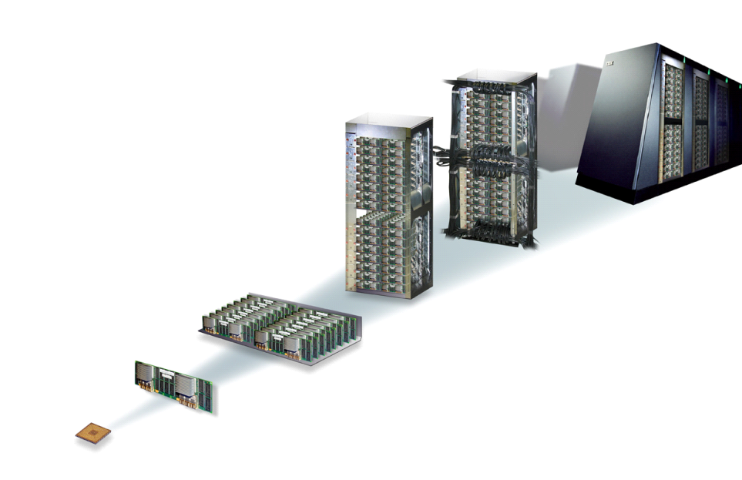
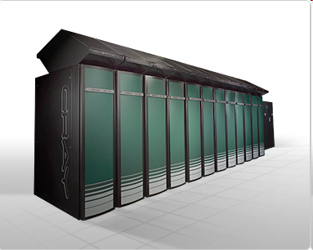
The common architectural landscape
SMP Clusters
SMP Node
SMP Node
. . .
. . .
. . .
PEs,
PEs,
PEs,
PEs,
Memory
Memory
Interconnect
Massively Parallel Processor Systems
IBM Blue Gene
Cray XT5

Slide 117
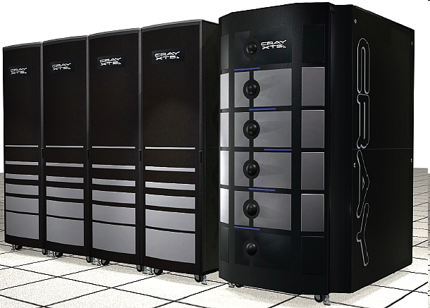
The heterogeneous/accelerated architectural landscape
I/O gateway nodes
• • •
(100’s of such
cluster nodes)
“Scalable Unit” Cluster Interconnect Switch/Fabric
Cray XT5h: FPGA/Vector-accelerated Opteron
Road Runner: Cell-accelerated Opteron

Slide 118
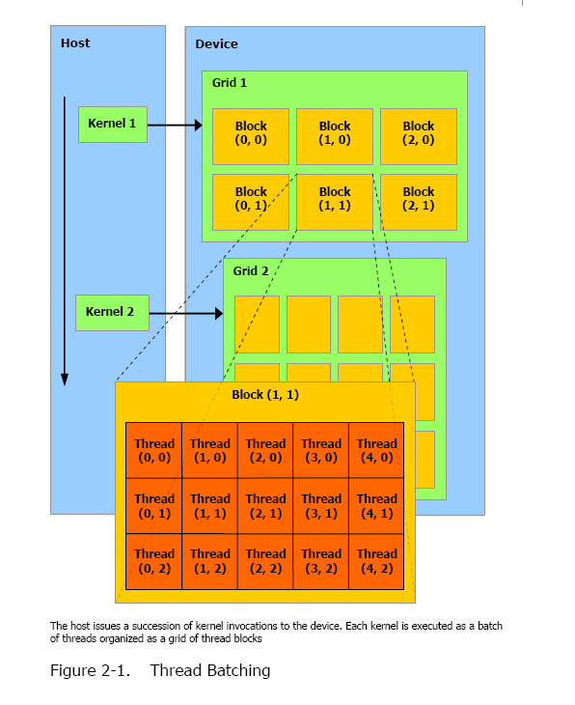
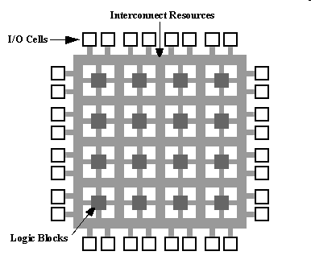
Example accelerator technologies
Place 1
Place 2
Place 3
Place 4
Place 5
Place 6
Place 7
Place 8
GPU
Place 0
From NVidia CUDA Programming Guide
Cell Processor
FPGA
Multi-core w/ accelerators (Intel IXP 2850)

Slide 119
The current architectural landscape
Substantial architectural innovation is anticipated over the next ten years.
Hardware situation remains murky, but programmers need stable interfaces to develop applications
Heterogenous accelerator-based systems will exist, raising serious programmability challenges.
Programmers must choreograph interactions between heterogenous processors, memory subsystems.
Multicore systems will dramatically raise the number of cores available to applications.
Programmers must understand concurrent structure of their applications.
Applications seeking to leverage these architectures will need to go beyond data-parallel, globally synchronizing MPI model.
These changes, while most profound for HPC now, will change the face of commercial computing over time.
Notes:
substantial [səb'stænʃəl]
基本翻译
adj. 大量的；实质的；内容充实的
n. 本质；重要材料
网络释义
substantial:实质的 | 坚固的 | 实质性的
anticipated [æn'tisipeit]
基本翻译
v. 预料（anticipate的过去分词）；盼望
adj. 预期的；期望的
网络释义
anticipated:预期的 | 预先的 | 参加
Murky黑暗
choreograph ['kɔriəɡrɑ:f]
基本翻译
vt. 设计舞蹈动作；为编舞
vi. 设计舞蹈动作
网络释义
choreograph:设计舞蹈动作

Slide 120
What is a programming model?
The logical interface between architecture and applications
Why Programming Models?
Decouple applications and architectures
Write applications that run effectively across architectures
Design new architectures that can effectively support legacy applications
Programming Model Design Considerations
Expose modern architectural features to exploit machine power and improve performance
Maintain Ease of Use

Slide 121
Examples of Parallel Programming Models
Message Passing
Shared Memory (Global Address Space)
Partitioned Global Address Space (PGAS)

Slide 122
The Message Passing Model
Concurrent sequential processes
Explicit communication, two-sided
Library-based
Positive:
Programmers control data and work distribution.
Negative:
Significant communication overhead for small transactions
Excessive buffering
Hard to program in
Example: MPI
Legend:
Thread/Process
Memory Access
Address Space
Message
Notes:
excessive [ik'sesiv]
基本翻译
adj. 过多的，极度的；过分的
网络释义
excessive:过度的 | 过分的 | 过多的

Slide 123
MPI
… But very low-level
Explicit, static management of handshakes is cumbersome, error-prone.
Explicit management of distribution is cumbersome, error-prone (cf MG, HPL)
Not suitable for fine-grained concurrency, adaptive computation, uneven task lengths
Code that is not Bulk Synchronous Parallel
Performance challenges from network support for one-sided memory access, multicore.
Library for message-passing
Standardized by MPI Forum (academics, industry) mid 90s.
Widely available with vendor-supported implementations.
By far the most widely used infrastructure in HPC for parallel computing.
Notes:
cumbersome ['kʌmbəsəm]
adj. 笨重的；难处理的；累赘的
uneven [,ʌn'i:vən]
adj. 不平坦的；奇数的；不均匀的
prone [prəun]
adj. 有…倾向的，易于…的；俯卧的
bulk [bʌlk]
n. 体积，容量；大块；大多数，大部分
vt. 使扩大，使形成大量；使显得重要

Slide 124
The Shared Memory Model
Concurrent threads with shared space
Positive:
Simple statements
Read remote memory via an expression
Write remote memory through assignment
Negative:
Manipulating shared data leads to synchronization requirements
Does not allow locality exploitation
Example: OpenMP, Java
Legend:
Thread/Process
Memory Access
Address Space
Notes:
exploitation [,eksplɔi'teiʃən]
n. 开发，开采；利用；广告推销

Slide 125
Java
Java 1.1 had support for multi-threading.
Program can create multiple threads.
Upto a limit.
Monitor-based concurrency control
wait, notify.
Monolithic heap – no support for distribution.
Cumbersome memory model.
Lock-based concurrency control … no support for lock-free algorithms.
No support for fine-grained concurrency.
No support for closures, value types.
Poor support for arrays.
Notes:
Monolithic heap 单一巨大的heap

Slide 126
Hybrid Model(s) Example: Shared + Message Passing
Network
…
…
…
Process
Thread
Address space
Example: OpenMP at the node (SMP), and MPI in between

Slide 127
The PGAS Model
Concurrent threads with a partitioned shared space
A datum may reference data in other partitions
Global arrays have fragments in multiple partitions
Positive:
Helps in exploiting locality
Simple statements as shared memory
Negative:
sharing all memory can result in subtle bugs and race conditions
Examples: This Tutorial! UPC, X10, Chapel, CAF, Titanium
PGAS
UPC, CAF, X10
Legend:
Thread/Process
Memory Access
Address Space
Notes:
subtle ['sʌtl]
adj. 微妙的；敏感的；狡猾的；精细的；稀薄的

Slide 128
PGAS vs. other programming models/languages
 | UPC, X10, Chapel | MPI | OpenMP | HPF
Memory model | PGAS (Partitioned Global Address Space) | Distributed Memory | Shared Memory | Distributed Shared Memory
Notation | Language | Library | Annotations | Language
Global arrays? | Yes | No | No | Yes
Global pointers/references? | Yes | No | No | No
Locality Exploitation | Yes | Yes, necessarily | No | Yes
Notes:
PGAS语言是共享变量模型和消息传递模型之间的一个有效的妥协方案。与MPI相比，具有抽象级高、可编程性好（共享存储的模型）、适合编译优化等优势。对于可扩展并行系统，该语言模型被认为是兼具可编程性和性能的近期解决方案，而被寄予厚望，得到了学术界和产业界的广泛参与

Slide 129
Asynchronous PGAS
Traditional PGAS languages like UPC and CAF specify
a single thread per place
all threads must operate in SPMD fashion.
not support heterogeneous accelerators very well.

Slide 130
Asynchronous PGAS
Legend:
Thread/Process
Memory Access
Address Space
Explicit concurrency
SPMD is a special case
Asynchronous activities can be started and stopped in a given space partition
Asynchronous activities can be used for active messaging
DMAs,
fork/join concurrency, do-all/do-across parallelism
Concurrency is made explicit and programmable.
Notes:
How is the data to be operated on? Traditional PGAS languages like UPC and CAF specify that there is a single thread per place, and that all threads must operate in SPMD fashion.
This is limiting and does not support heterogenous accelerators very well. Instead we propose to make concurrency explicit and programmable by introducing the notion of an activity.
A place may have one or more activities operating on the data. Multiple activities in the same place may execute in parallel, provided the place is mapped onto multiple cores. Related control constructs, such as “finish” support a fork/join style of parallelism (a la OpenMP and Cilk). An activity may spawn another activity in a remote place --- this provides the basis for DMAs and messaging (a la MPI). One place may be mapped onto a single core (e.g. an Opteron core), whereas another place may be mapped onto multiple execution threads (e.g. a GPGPU).

Slide 131
Instead-Asynchronous PGAS
propose to make concurrency explicit and programmable
by introducing the notion of an activity.
A place may have one or more activities operating on the data.
Multiple activities in the same place may execute in parallel, provided the place is mapped onto multiple cores.
Related control constructs, such as “finish” support a fork/join style of parallelism (a la OpenMP and Cilk).
An activity may spawn another activity in a remote place --- this provides the basis for DMAs and messaging (a la MPI).
One place may be mapped onto a single core (e.g. an Opteron core), whereas another place may be mapped onto multiple execution threads (e.g. a GPGPU).

Slide 132
How to realize APGAS?
Through an APGAS library in C, Fortran, Java (co-habiting with MPI)
Through languages
Notes:
It is important to provide a migration path to our customers, particularly those using C/Fortran + MPI. To this end, we propose the development of an APGAS library in C, Fortran and Java that can be used side-by-side with MPI. Existing applications can be moved slowly over to use more and more APGAS features and fewer MPI features. (Some customers may choose to stay with this model.)
At the same time we propose to develop Asynchronous CAF (ACAF), Asynchronous UPC (AUPC) and continue to develop X10 (which was already designed to be asynchronous). These languages provide integrated support for APGAS, thereby significantly improving programmer productivity (at the cost of language support). By developing APGAS in three streams – Fortran, C and Java – we offer our customers the choice to move to the programming language that works best for their application and programmer base. For instance, the Java stream (X10) offers more much more robust static checking for concurrency and distribution errors and significant flexibility (OO model). The Fortran stream (ACAF) offers potentially better performance (but not as much flexibility and static error-checking). The C stream offers more flexibility (than Fortran) but not as much error-checking as the Java stream.
By developing the APGAS languages on a common runtime we will be able to develop the exciting option of *parallel interoperability* between codes written in the C/Fortran/Java streams.

Slide 133
How to realize APGAS?
Through an APGAS library in C, Fortran, Java (co-habiting with MPI)
Implements PGAS
Remote references
Global data-structures
Implements inter-place messaging
Optimizes inlinable asyncs
Implements global and/or collective operations
Implements intra-place concurrency
Atomic operations
Algorithmic scheduler
Builds on XL UPC runtime, GASNet, ARMCI, LAPI, DCMF, DaCS, Cilk runtime, Chapel runtime
Libraries reduce cost of adoption, languages offer enhanced productivity benefits
Customer gets to choose
Notes:
It is important to provide a migration path to our customers, particularly those using C/Fortran + MPI. To this end, we propose the development of an APGAS library in C, Fortran and Java that can be used side-by-side with MPI. Existing applications can be moved slowly over to use more and more APGAS features and fewer MPI features. (Some customers may choose to stay with this model.)
At the same time we propose to develop Asynchronous CAF (ACAF), Asynchronous UPC (AUPC) and continue to develop X10 (which was already designed to be asynchronous). These languages provide integrated support for APGAS, thereby significantly improving programmer productivity (at the cost of language support). By developing APGAS in three streams – Fortran, C and Java – we offer our customers the choice to move to the programming language that works best for their application and programmer base. For instance, the Java stream (X10) offers more much more robust static checking for concurrency and distribution errors and significant flexibility (OO model). The Fortran stream (ACAF) offers potentially better performance (but not as much flexibility and static error-checking). The C stream offers more flexibility (than Fortran) but not as much error-checking as the Java stream.
By developing the APGAS languages on a common runtime we will be able to develop the exciting option of *parallel interoperability* between codes written in the C/Fortran/Java streams.

Slide 134
How to realize APGAS?
Through languages
Asynchronous Co-Array Fortran
extension of CAF with asyncs
Asynchronous UPC (AUPC)
Proper extension of UPC with asyncs
X10 (already asynchronous)
Extension of sequential Java
Chapel (already asynchronous)
Language runtimes share common APGAS runtime
Notes:
It is important to provide a migration path to our customers, particularly those using C/Fortran + MPI. To this end, we propose the development of an APGAS library in C, Fortran and Java that can be used side-by-side with MPI. Existing applications can be moved slowly over to use more and more APGAS features and fewer MPI features. (Some customers may choose to stay with this model.)
At the same time we propose to develop Asynchronous CAF (ACAF), Asynchronous UPC (AUPC) and continue to develop X10 (which was already designed to be asynchronous). These languages provide integrated support for APGAS, thereby significantly improving programmer productivity (at the cost of language support). By developing APGAS in three streams – Fortran, C and Java – we offer our customers the choice to move to the programming language that works best for their application and programmer base. For instance, the Java stream (X10) offers more much more robust static checking for concurrency and distribution errors and significant flexibility (OO model). The Fortran stream (ACAF) offers potentially better performance (but not as much flexibility and static error-checking). The C stream offers more flexibility (than Fortran) but not as much error-checking as the Java stream.
By developing the APGAS languages on a common runtime we will be able to develop the exciting option of *parallel interoperability* between codes written in the C/Fortran/Java streams.

Slide 135
Supplement on X10

Slide 136
What is X10?
X10 is a new language developed in the IBM PERCS project as part of the DARPA program on High Productivity Computing Systems (HPCS)
X10 is an instance of the APGAS framework in the Java family
X10
Is more productive than current models
Can support high levels of abstraction
Can exploit multiple levels of parallelism and non-uniform data access
Is suitable for multiple architectures, and multiple workloads.

Slide 137
Parallel HelloWorld
import x10.io.Console;
class HelloWorldPar {
public static def main(args:Rail[String]):void {
finish ateach (p in Dist.makeUnique()) {
Console.OUT.println("Hello World from Place" +p);
}
}
}
(%1) x10c++ -o HelloWorldPar -O HelloWorldPar.x10
(%2) mpirun -n 4 HelloWorldPar
Hello World from Place(0)
Hello World from Place(2)
Hello World from Place(3)
Hello World from Place(1)
(%3)

Slide 138
X10 Compilation
X10 Compiler Front End
X10 Source
Front End
X10 AST
AST-based optimizations
AST- Lowering
X10 AST
C++ Backend
Java Backend
C++ Back End
Java Back End
XRX C++ Natives
C++
Java
XRX Java Natives
C++ Post-compiler
javac
X10RT/PGAS
Executable
Bytecode
JVM

Slide 139
Overview of Features
Many sequential features of Java inherited unchanged
Classes (w/ single inheritance)
Interfaces, (w/ multiple inheritance)
Instance and static fields
Constructors, (static) initializers
Overloaded, over-rideable methods
Garbage collection
Structs
Closures
Points, Regions, Distributions, Arrays
Substantial extensions to the type system
Dependent types
Generic types
Function types
Type definitions, inference
Concurrency
Fine-grained concurrency:
async (p,l) S
Atomicity
atomic (s)
Ordering
L: finish S
Data-dependent synchronization
when (c) S
Notes:
Substantial坚固的; 结实的

Slide 140
Classes
Single inheritance, multiple interfaces
May have mutable instance fields
Values of class types may be null
Heap allocated
Distributed Object Model
Remote references with global identity
Rooted state: lives in place where object was created
Global state
programmer specified subset of immutable state
serialized with object; available anywhere that has remote ref
methods may be global as well (access only global state)
Global/Rooted new in X10 2.0
Notes:
mutable ['mju:təbl]
基本翻译
adj. 易变的，不定的；性情不定的
网络释义
mutable:可变的 | 易变的 | 变动
immutable [i'mju:təbl]
基本翻译
adj. 不变的；不可变的；不能变的
网络释义
immutable:不可变的 | 不变模式 | 不变

Slide 141
Structs
User defined primitives
No inheritance
May implement interfaces
All fields are final
All methods are final
Allocated “inline” in containing object/array/variable
Headerless
Instances of structs may be freely copied from place to place
struct Complex {
val real:double;
val img : double;
def this(r:double, i:double) {
real = r; img = i;
}
def operator + (that:Complex) {
return
Complex(real + that.real,
img + that.img);
}
....
}
val x = Array[Complex](Dist).make
New in X10 2.0

Slide 142
Points
A point is an element of an n-dimensional Cartesian space (n>=1) with integer-valued coordinates e.g., [5], [1, 2], …
A point variable can hold values of different ranks e.g.,
var p: Point = [1]; p = [2,3]; ...
Operations
p1.rank
returns rank of point p1
p1(i)
returns element (i mod p1.rank) if i < 0 or i >= p1.rank
p1 < p2, p1 <= p2, p1 > p2, p1 >= p2
returns true iff p1 is lexicographically <, <=, >, or >= p2
only defined when p1.rank and p2.rank are equal
Notes:
ZPL 中的内存模型比较简单：数据要么是复制存在，要么是分布的。
并行数组是分布的；标量和索引数组是各个处理器上复制存在的。复制版本的一致性由编译器维护。ZPL程序的并行性全部是隐式的，处理器之间的通信全部由并行操作符描述（与APL不同的是，并行操作符不到20个），从中可以知道通信的类型。在ZPL中，同步都是隐含在语言模型中的，竞争条件和死锁都不可能发生。
区域（region）是ZPL的核心概念，可以描述一个具有跨度的凸形索引集，也能描述稀疏的索引集，本身没有与之关联的数据。区域的用途有两个：声明并行数组，指明并行数组计算的索引集。区域有一些特定的二元操作 — 前置操作。这些操作作用于一个区域和一个方向向量，可以建立新的区域，能方便地描述shift区域、扩张和内缩、邻接区域（边界条件初始化）。
数据分布由多个层次的概念实现：grid 描述一个处理器拓扑；distribution结构描述索引到grid的映射；并行数组的声明必须用region，该索引集声明在某个distribution上，也就确定了并行数组的数据分布。（需要指出的是，ZPL区分并行数组和索引数组。并行数组是不能被索引访问的，以此区别于索引数组。）
在计算划分方面：区域控制的是整个语句的访问范围，数组操作符可以方便地调整每个数组引用点。以下是一些主要的数组操作符：<<（归约操作）、||（扫描操作）、>>（泛洪操作）、#（remap操作，是gather/scatter的拓展）、@（偏移操作）、@^（环绕偏移操作，支持周期性的边界条件）等等。

Slide 143
Region
Regions are collections of points of the same dimension
Rectangular regions have a simple representation, e.g. [1..10, 3..40]
Rich algebra over regions is provided
Null: Region = new Region(); // Empty 0-dimensional region
R1: Region = 1..100; // 1-dim region with extent 1..100
R2: Region = [1..100]; // same as R1
R3: Region = (0..99) * (-1..MAX_HEIGHT);
R4: Region = [0..99, -1..MAX_HEIGHT]; // same as R3
R5: Region = Region.factory.upperTriangular(N);
R6: Region = Region.factory.banded(N, K);
R7: Region = R4 && R5; // intersection of two regions
R8: Region = R4 || R5; // union of two regions

Slide 144
Distributions
Distributions specify mapping of points in a region to places
E.g. Dist.makeBlock(R)
E.g. Dist.makeUnique()
R: Region = 1..100;
D: Dist = Dist.block(R);
D: Dist = Dist.cyclic(R);
D: Dist = R -> here;
D: Dist = Dist.random(R);
Let D be a distribution.
D.region denotes the underlying region.
D.places is the set of places constituting the range of D (viewed as a function).
Given a point p, the expression D(p) represents the application of D to p, that is, the place that p is mapped to by D.
Let R be a region, Q a set of places {p1, . . . , pk} (enumerated in canonical order),and P a place.
All the operations described below may be performed on Dist.factory.
Notes:
ZPL语言的基本元素是region，它包含了并行
性。一个region就是一个指标集。例如：region R =
[1..n,1..n]。赋值语言也进行了扩展，使得两边元素
可以是region，例如[R] Obj := S，region R对赋值的
范围进行了限定。ZPL提供一系列region相关操作。
首先定义了方向(directions)，例如direction north =
[-1,0]; east = [0,+1]。方向可以与三个操作符一起使
用，of，in和at。of操作符在源region的外部在指定的
方向上产生一个新的region。in操作符在源region的
内部产生一个region。at操作符相当于在指定方向上
移动整个region。ZPL也提供一组数组操作符，例如
reduce(<<)，floods(>>)，remap(#)和scan(||)。

Slide 145
Unique distribution：
The distribution unique(Q) is the unique distribution from the region 1:k to Q mapping each point i to pi.
Constant distributions.
The distribution R->P maps every point in R to P.
Block distribution
The distribution block(R, Q) distributes the elements of R (in order) over the set of places Q in blocks
Cyclic distribution
The distribution cyclic(R, Q) distributes the points in R cyclically across places in Q in order.

Slide 146
Array operations
A.rank ::= # dimensions in array
A.region ::= index region (domain) of array
A.dist ::= distribution of array A
A(p) ::= element at point p, where p belongs to A.region
A(R) ::= restriction of array onto region R
Useful for extracting subarrays
Arrays are defined over a distribution and a base type
A:Array[T]
A:Array[T](d)
Arrays are created through initializers
Array.make[T](d, init)
Arrays are mutable (considering immutable arrays)

Slide 147
Rail
A rail is a one-dimensional, zero-based, local array.
It is more primitive than the Array class.
Rails are indexed by integers rather than multi-dimensional points.
Rails have a single length property of type Int.
Rails can be mutable or immutable and are defined by the following class definitions:
package x10.lang;
public class Val Rail[T](length: Int) extends (Int)=>T { }
public class Rail[T](length: Int) extends (Int)=>T, Settable[Int,T] { }

Slide 148
Generic classes
Classes and interfaces may have type parameters
class Rail[T]
Defines a type constructor Rail
and a family of types Rail[int], Rail[String], Rail[Object], Rail[C], ...
Rail[C]: as if Rail class is copied and C substituted for T
Can instantiate on any type, including primitives (e.g., int)
public abstract value class Rail[T]
(length: int)
implements Indexable[int,T], Settable[int,T]
{
private native def this(n: int): Rail[T]{length==n};
public native def get(i: int): T;
public native def apply(i: int): T;
public native def set(v: T, i: int): void;
}
Notes:
agglomeration [ə,ɡlɔmə'reiʃən]
基本翻译
n. 凝聚；结块；附聚
网络释义
agglomeration:烧结 | 结块 | 凝聚
4.12.4 Rails
A rail is a one-dimensional, zero-based, local array. It is more primitive than the
Array class. Rails are indexed by integers rather than multi-dimensional points.
Rails have a single length property of type Int. Rails can be mutable or immutable
and are defined by the following class definitions:
package x10.lang;
public class ValRail[T](length: Int) extends (Int)=>T { }
public class Rail[T](length: Int) extends (Int)=>T, Settable[Int,T] { }
X10 supports shorthand syntax for rail construction (x12.29).

Slide 149
Function Types
(T₁, T₂, ..., T_{n}) => U
type of functions that take arguments T_{i} and returns U
If f: (T) => U and x: T
then invoke with f(x): U
Function types can be used as an interface
Define apply method with the appropriate signature:
def apply(x:T): U
Closures
First-class functions
(x: T): U => e
used in array initializers:
Array.make[int]( 0..4, (p: point) => p(0)*p(0) )
the array [ 0, 1, 4, 9, 16 ]
Operators
int.+, boolean.&, ...
sum = a.reduce(int.+, 0)

Slide 150
Type inference
Field, local variable types inferred from initializer type
val x = 1;
x has type int{self==1}
val y = 1..2;
y has type Region{rank==1}
Method return types inferred from method body
def m() { ... return true ... return false ... }
m has return type boolean
Loop index types inferred from region
R: Region{rank==2}
for (p in R) { ... }
p has type Point{rank==2}
Place type inference implemented in X10 2.0

Slide 151
when
Stmt ::= WhenStmt
WhenStmt ::= when ( Expr ) Stmt
| WhenStmt or (Expr) Stmt
when (E) S
Activity suspends until a state in which the guard E is true.
In that state, S is executed atomically and in isolation.
Guard E is a boolean expression
must be nonblocking
must not create concurrent activities (sequential)
must not access remote data (local)
must not have side-effects (const)
await (E)
syntactic shortcut for when (E) ;
class OneBuffer {
var datum:Object = null;
var filled:Boolean = false;
def send(v:Object) {
when ( !filled ) {
datum = v;
filled = true;
}
}
def receive():Object {
when ( filled ) {
val v = datum;
datum = null;
filled = false;
return v;
}
}
}

Slide 152
Clocks: Motivation
Activity coordination using finish is accomplished by checking for activity termination
But in many cases activities have a producer-consumer relationship and a “barrier”-like coordination is needed without waiting for activity termination
The activities involved may be in the same place or in different places
Design clocks to offer determinate and deadlock-free coordination between a dynamically varying number of activities.
Phase 0
Phase 1
. . .
Activity 0
Activity 1
Activity 2
. . .
Notes:
determinate [di'tə:minət]
基本翻译
adj. 确定的；决定的
vt. 确定；弄清楚

Slide 153
Clocks: Main operations
var c = Clock.make();
Allocate a clock, register current activity with it. Phase 0 of c starts.
async(…) clocked (c₁,c₂,…) S
ateach(…) clocked (c₁,c₂,…) S
foreach(…) clocked (c₁,c₂,…) S
Create async activities registered on clocks c₁, c₂, …
c.resume();
Nonblocking operation that signals completion of work by current activity for this phase of clock c
next;
Barrier — suspend until all clocks that the current activity is registered with can advance. c.resume() is first performed for each such clock, if needed.
next can be viewed like a “finish” of all computations under way in the current phase of the clock
Notes:
barrier ['bæriə]
基本翻译
n. 障碍物，屏障；界线
vt. 把…关入栅栏
网络释义
barrier:障碍 | 屏障 | 妨碍

Slide 154
Thanks

Slide 155
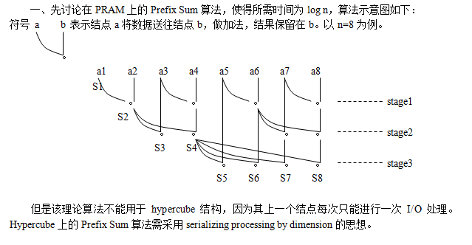
Notes:
并行计算机没有一个统一的计算模型。不过，人们已经提出了几种有价值的参考模型：PRAM模型，BSP模型，LogP模型，C^3模型等。 对于多核计算 主要介绍下 pram模型 PRAM（Parallel Random Access Machine）模型是单指令流多数据流（SIMD）并行机中的一种具有共享存储的模型。它假设有一个无限大容量的共享存储器，并且有多个功能相同的处理器，在任意时刻处理器可以访问共享存储单元。根据是否可以同时读写，它又分为以下三类： 分类 1PRAM-CRCW并发读并发写 1.1CPRAM-CRCW(Common PRAM-CRCW)：仅允许写入相同数据 1.2PPRAM-CRCW(Priority PRAM-CRCW)：仅允许优先级最高的处理器写入 1.3APRAM-CRCW(Arbitrary PRAM-CRCW)：允许任意处理器自由写入 2.PRAM-CREW并发读互斥写 3.PRAM-EREW互斥读互斥写 计算能力比较 PRAM-CRCW是最强的计算模型，PRAM-EREW可logp倍模拟PRAM-CREW和PRAM-CRCW PRAM-EREW，PRAM-CREW，PRAM-CRCW（其中C代表Cuncurrent，意为允许并发操作，E-代表Exclusive，意味排斥并发操作）。在PRAM中有一个同步时钟，所有的操作都是同步进行的。 缺点与优点 缺点是不现实，首先容量无限大的存储器是不存在的，而且由于各方面的原因，全局访存通常要比预想的慢。其次，他忽略了通信带宽的影响。 优点是结构简单，便于进行理论分析。 变体 具有局部存储器的PRAM模型称作LPRAM模型，具有异步时钟的PRAM模型称作APRAM模型。 APRAM模型 基本定义 APRAM指的是异步的PRAM模型，A代表Asynchrinize。显然，APRAM是一种MIMD模型。在有的文献上，APRAM也称作Phased PRAM（分相PRAM）。 特点 APRAM最重要的特点是处理器均工作在异步模式下，即处理器有自己的控制器，局部存储器以及局部程序。处理器间的同步问题通过添加同步路障（Synchronization Barrier）来解决。这样，计算被分割成一些列的相（Phase），每一相类不允许两个处理器去访问同一存储单元。而局部程序的最后一条指令一定是同步指令。显然，同步路障的时间是由最后一个到达的处理器决定的，也就是说，先执行完局部程序的处理器必须等到执行的最慢的那个处理器来一起完成同步路障。 详细内容 参考《并行计算导论》

Slide 156
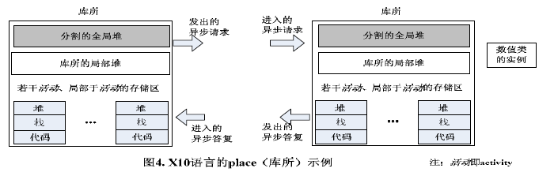

Slide 157
